Slide 1
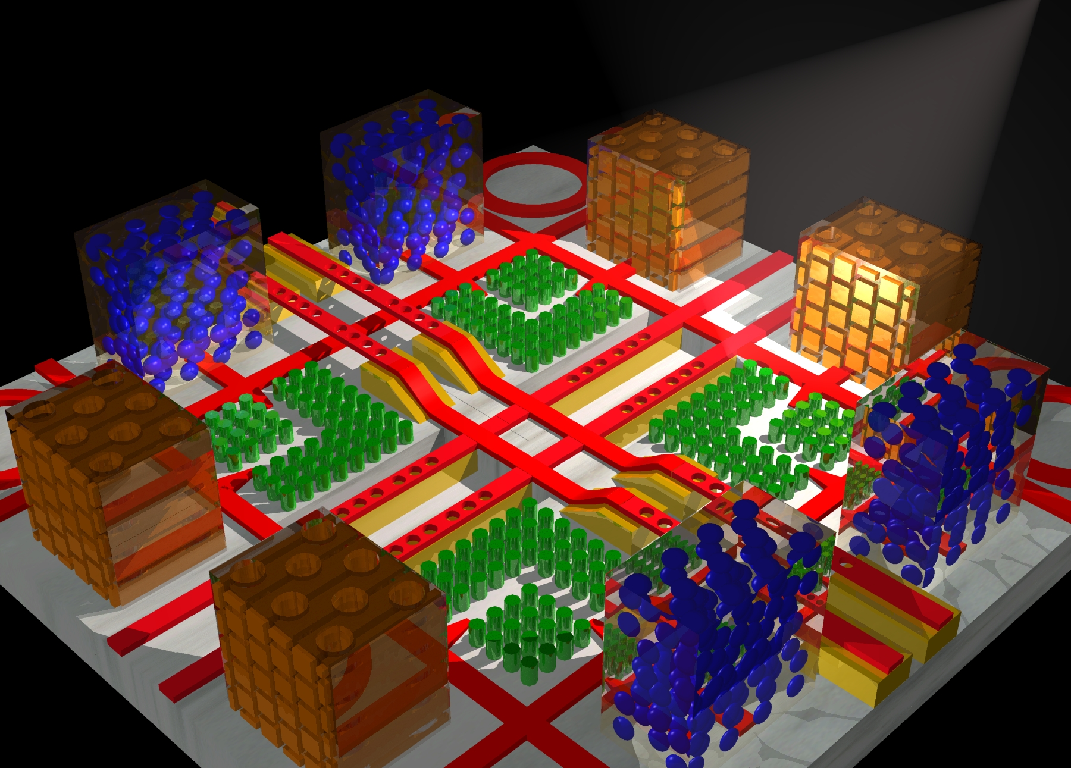
Photonic Crystals:
A Crash Course in Designer Electromagnetism
Steven G. Johnson
MIT Applied Mathematics

Slide 2
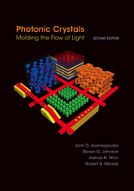
Free Materials Online
Photonic Crystals book: jdj.mit.edu/book
Tutorial slides: jdj.mit.edu/photons/tutorial
Free electromagnetic simulation software
(FDTD, mode solver, etc.)
jdj.mit.edu/wiki

Slide 3
Outline
Preliminaries: waves in periodic media
Photonic crystals in theory and practice
Bulk crystal properties
Intentional defects and devices
Index-guiding and incomplete gaps
Photonic-crystal fibers
Perturbations, tuning, and disorder

Slide 4
Outline
Preliminaries: waves in periodic media
Photonic crystals in theory and practice
Bulk crystal properties
Intentional defects and devices
Index-guiding and incomplete gaps
Photonic-crystal fibers
Perturbations, tuning, and disorder

Slide 5
To Begin: A Cartoon in 2d
scattering
planewave

Slide 6
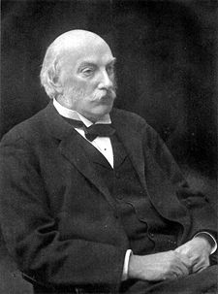
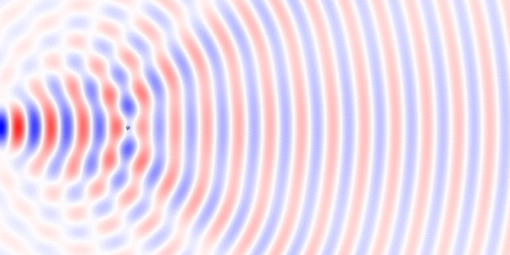
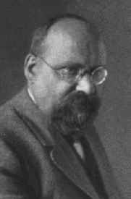
…Waves Can Scatter
small particles:
Lord Rayleigh (1871)
why the sky is blue
here: a little circular speck of silicon
checkerboard pattern: interference of waves
traveling in different directions
scattering by spheres:
solved by Gustave Mie (1908)

Slide 7
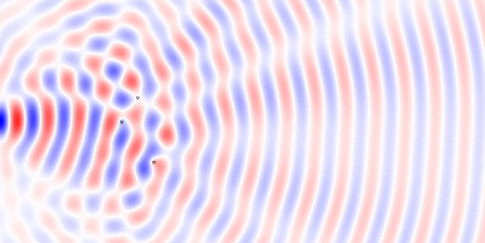
Multiple Scattering is Just Messier?
here: scattering off three specks of silicon
can be solved on a computer, but not terribly interesting…

Slide 8
To Begin: A Cartoon in 2d
•
•
•
•
•
•
•
•
•
•
•
•
a
•
•
•
•
•
•
•
•
•
•
•
•
•
•
•
•
•
•
•
•
•
•
•
•
•
•
•
•
•
•
•
•
•
•
•
•
•
•
•
•
•
•
•
•
•
•
•
•
•
•
•
planewave
•
•
•
•
•
•
•
•
•
for most λ, beam(s) propagate
through crystal without scattering
(scattering cancels coherently)
...but for some λ (~ 2a), no light can propagate: a photonic band gap

Slide 9
An even bigger mess? zillons of scatterers
Blech, light will just scatter like crazy
and go all over the place … how boring!

Slide 10
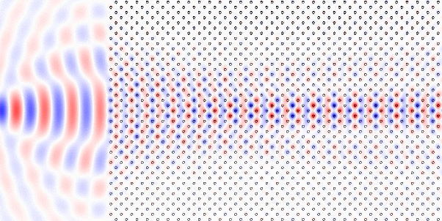
Not so messy, not so boring…
the light seems to form several coherent beams
that propagate without scattering
… and almost without diffraction (supercollimation)

Slide 11
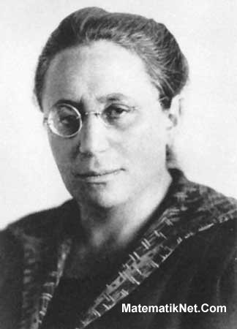
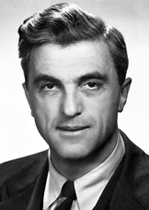
…the magic of symmetry…
Noether’s theorem:
symmetry = conservation laws
In this case, periodicity
= conserved “momentum”
= wave solutions without scattering
[ Bloch waves ]
[ Emmy Noether, 1915 ]
Felix Bloch
(1928)

Slide 12
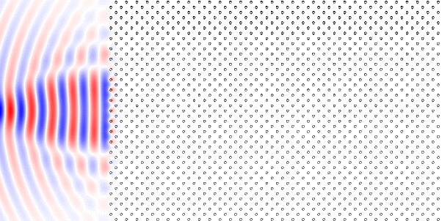
A slight change? Shrink λ by 20% an “optical insulator” (photonic bandgap)
light cannot penetrate the structure at this wavelength!
all of the scattering destructively interferes

Slide 13
Photonic Crystals
periodic electromagnetic media
1887
1987
(need a more complex topology)
with photonic band gaps: “optical insulators”

Slide 14
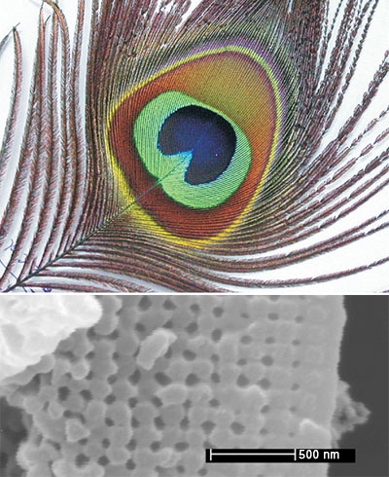
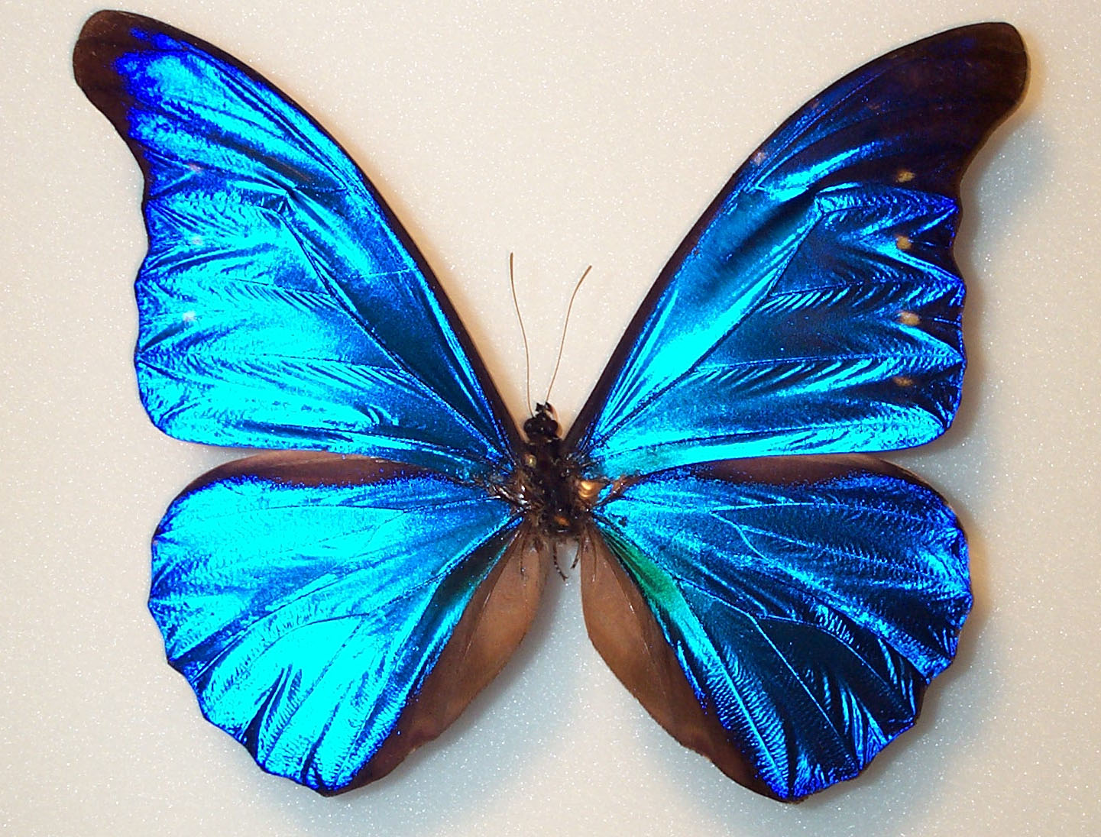
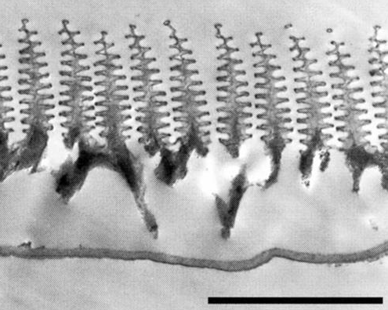
Photonic Crystals in Nature
Peacock feather
Morpho rhetenor butterfly
http://www.bugguy012002.com/MORPHIDAE.html
wing scale:
[ P. Vukosic et al., Proc. Roy. Soc: Bio. Sci. 266, 1403 (1999) ]
3µm
[J. Zi et al, Proc. Nat. Acad. Sci. USA,
100, 12576 (2003) ]
[figs: Blau, Physics Today 57, 18 (2004)]
[ also: B. Gralak et al., Opt. Express 9, 567 (2001) ]

Slide 15
Photonic Crystals
periodic electromagnetic media
can trap light in cavities
and waveguides (“wires”)
with photonic band gaps:
“optical insulators”
for holding and controlling light

Slide 16
Photonic Crystals
periodic electromagnetic media
But how can we understand such complex systems?
Add up the infinite sum of scattering? Ugh!

Slide 17
A mystery from the 19th century
conductive material
+
+
e–
+
e–
+
+
current:
conductivity (measured)
mean free path (distance) of electrons

Slide 18
A mystery from the 19th century
crystalline conductor (e.g. copper)
+
+
+
+
+
+
+
+
10’s
of
periods!
e–
+
+
+
+
+
+
+
+
+
+
+
+
+
+
+
+
e–
+
+
+
+
+
+
+
+
current:
conductivity (measured)
mean free path (distance) of electrons

Slide 19
A mystery solved…
1
electrons are waves (quantum mechanics)
waves in a periodic medium can propagate without scattering:
Bloch’s Theorem (1d: Floquet’s)
2
The foundations do not depend on the specific wave equation.

Slide 20
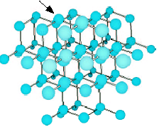
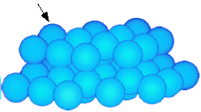
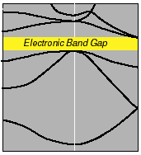
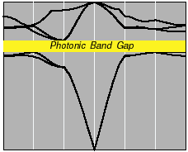
Electronic and Photonic Crystals
atoms in diamond structure
dielectric spheres, diamond lattice
Periodic
Medium
Bloch waves:
Band Diagram
photon frequency
electron energy
wavevector
wavevector
strongly interacting fermions
weakly-interacting bosons

Slide 21
Time to Analyze the Cartoon
•
•
•
•
•
•
•
•
•
•
•
•
a
•
•
•
•
•
•
•
•
•
•
•
•
•
•
•
•
•
•
•
•
•
•
•
•
•
•
•
•
•
•
•
•
•
•
•
•
•
•
•
•
•
•
•
•
•
•
•
•
•
•
•
planewave
•
•
•
•
•
•
•
•
•
for most λ, beam(s) propagate
through crystal without scattering
(scattering cancels coherently)
...but for some λ (~ 2a), no light can propagate: a photonic band gap

Slide 22
Fun with Math
First task:
get rid of this mess
0
dielectric function ε(x) = n²(x)
+ constraint
eigen-operator
eigen-value
eigen-state

Slide 23
Hermitian Eigenproblems
+ constraint
eigen-operator
eigen-value
eigen-state
Hermitian for real (lossless) ε
well-known properties from linear algebra:
ω are real (lossless)
eigen-states are orthogonal
eigen-states are complete (give all solutions)*
* Technically, completeness requires slightly more than just Hermitian-ness.

Slide 24
Periodic Hermitian Eigenproblems
[ G. Floquet, “Sur les équations différentielles linéaries à coefficients périodiques,” Ann. École Norm. Sup. 12, 47–88 (1883). ]
[ F. Bloch, “Über die quantenmechanik der electronen in kristallgittern,” Z. Physik 52, 555–600 (1928). ]
if eigen-operator is periodic, then Bloch-Floquet theorem applies:
can choose:
planewave
periodic “envelope”
Corollary 1: k is conserved, i.e. no scattering of Bloch wave
Corollary 2: given by finite unit cell,
so ω are discrete ω_{n}(k)

Slide 25
Periodic Hermitian Eigenproblems
Corollary 2: given by finite unit cell,
so ω are discrete ω_{n}(k)
band diagram (dispersion relation)
ω₃
map of
what states
exist &
can interact
ω₂
ω
ω₁
?
k
range of k?

Slide 26
Periodic Hermitian Eigenproblems in 1d
ε₁
ε₂
ε₁
ε₂
ε₁
ε₂
ε₁
ε₂
ε₁
ε₂
ε₁
ε₂
a
ε(x) = ε(x+a)
Consider k+2π/a:
periodic!
k is periodic:
k + 2π/a equivalent to k
“quasi-phase-matching”
satisfies same
equation as H_{k}
= H_{k}

Slide 27
Periodic Hermitian Eigenproblems in 1d
k is periodic:
k + 2π/a equivalent to k
“quasi-phase-matching”
ε₁
ε₂
ε₁
ε₂
ε₁
ε₂
ε₁
ε₂
ε₁
ε₂
ε₁
ε₂
a
ε(x) = ε(x+a)
ω
band gap
k
–π/a
0
π/a
irreducible Brillouin zone

Slide 28
Any 1d Periodic System has a Gap
[ Lord Rayleigh, “On the maintenance of vibrations by forces of double frequency, and on the propagation of waves through a medium endowed with a periodic structure,” Philosophical Magazine 24, 145–159 (1887). ]
Start with
a uniform (1d) medium:
ε₁
ω
k
0

Slide 29
Any 1d Periodic System has a Gap
[ Lord Rayleigh, “On the maintenance of vibrations by forces of double frequency, and on the propagation of waves through a medium endowed with a periodic structure,” Philosophical Magazine 24, 145–159 (1887). ]
Treat it as
“artificially” periodic
ε₁
a
ε(x) = ε(x+a)
bands are “folded”
by 2π/a equivalence
ω
k
–π/a
0
π/a

Slide 30
Any 1d Periodic System has a Gap
[ Lord Rayleigh, “On the maintenance of vibrations by forces of double frequency, and on the propagation of waves through a medium endowed with a periodic structure,” Philosophical Magazine 24, 145–159 (1887). ]
Treat it as
“artificially” periodic
a
ε(x) = ε(x+a)
ε₁
ω
0
π/a
x = 0

Slide 31
Any 1d Periodic System has a Gap
[ Lord Rayleigh, “On the maintenance of vibrations by forces of double frequency, and on the propagation of waves through a medium endowed with a periodic structure,” Philosophical Magazine 24, 145–159 (1887). ]
Add a small
“real” periodicity
ε₂ = ε₁ + Δε
a
ε(x) = ε(x+a)
ε₁
ε₂
ε₁
ε₂
ε₁
ε₂
ε₁
ε₂
ε₁
ε₂
ε₁
ε₂
ω
0
π/a
x = 0

Slide 32
Any 1d Periodic System has a Gap
[ Lord Rayleigh, “On the maintenance of vibrations by forces of double frequency, and on the propagation of waves through a medium endowed with a periodic structure,” Philosophical Magazine 24, 145–159 (1887). ]
Splitting of degeneracy:
state concentrated in higher index (ε₂)
has lower frequency
Add a small
“real” periodicity
ε₂ = ε₁ + Δε
a
ε(x) = ε(x+a)
ε₁
ε₂
ε₁
ε₂
ε₁
ε₂
ε₁
ε₂
ε₁
ε₂
ε₁
ε₂
ω
band gap
0
π/a
x = 0

Slide 33
Some 2d and 3d systems have gaps
• In general, eigen-frequencies satisfy Variational Theorem:
“kinetic”
inverse
“potential”
bands “want” to be in high-ε
…but are forced out by orthogonality
➔ band gap (maybe)

Slide 34
A 2d Model System
a
Square lattice of dielectric rods (ε = 12 ~ Si) in air (ε = 1)

Slide 35
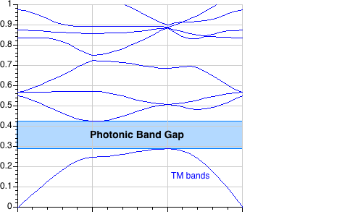
Solving the Maxwell Eigenproblem
Finite cell ➔ discrete eigenvalues ω_{n}
Want to solve for ω_{n}(k),
& plot vs. “all” k for “all” n,
constraint:
where magnetic field = H(x) e^{i(k•x – ωt)}
1
Limit range of k: irreducible Brillouin zone
2
Limit degrees of freedom: expand H in finite basis
3
Efficiently solve eigenproblem: iterative methods

Slide 36
Solving the Maxwell Eigenproblem: 1
1
Limit range of k: irreducible Brillouin zone
—Bloch’s theorem: solutions are periodic in k
M
k_{y}
first Brillouin zone
= minimum |k| “primitive cell”
Γ
X
k_{x}
irreducible Brillouin zone: reduced by symmetry
2
Limit degrees of freedom: expand H in finite basis
3
Efficiently solve eigenproblem: iterative methods

Slide 37
Solving the Maxwell Eigenproblem: 2a
1
Limit range of k: irreducible Brillouin zone
2
Limit degrees of freedom: expand H in finite basis (N)
solve:
finite matrix problem:
3
Efficiently solve eigenproblem: iterative methods

Slide 38
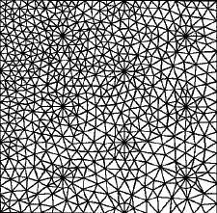
Solving the Maxwell Eigenproblem: 2b
1
Limit range of k: irreducible Brillouin zone
2
Limit degrees of freedom: expand H in finite basis
— must satisfy constraint:
Planewave (FFT) basis
Finite-element basis
constraint, boundary conditions:
Nédélec elements
[ Nédélec, Numerische Math.
35, 315 (1980) ]
constraint:
nonuniform mesh,
more arbitrary boundaries,
complex code & mesh, O(N)
uniform “grid,” periodic boundaries,
simple code, O(N log N)
[ figure: Peyrilloux et al.,
J. Lightwave Tech.
21, 536 (2003) ]
3
Efficiently solve eigenproblem: iterative methods

Slide 39
Solving the Maxwell Eigenproblem: 3a
1
Limit range of k: irreducible Brillouin zone
2
Limit degrees of freedom: expand H in finite basis
3
Efficiently solve eigenproblem: iterative methods
Slow way: compute A & B, ask LAPACK for eigenvalues
— requires O(N²) storage, O(N³) time
Faster way:
— start with initial guess eigenvector h₀
— iteratively improve
— O(Np) storage, ~ O(Np²) time for p eigenvectors
(p smallest eigenvalues)

Slide 40
Solving the Maxwell Eigenproblem: 3b
1
Limit range of k: irreducible Brillouin zone
2
Limit degrees of freedom: expand H in finite basis
3
Efficiently solve eigenproblem: iterative methods
Many iterative methods:
— Arnoldi, Lanczos, Davidson, Jacobi-Davidson, …,
Rayleigh-quotient minimization

Slide 41
Solving the Maxwell Eigenproblem: 3c
1
Limit range of k: irreducible Brillouin zone
2
Limit degrees of freedom: expand H in finite basis
3
Efficiently solve eigenproblem: iterative methods
Many iterative methods:
— Arnoldi, Lanczos, Davidson, Jacobi-Davidson, …,
Rayleigh-quotient minimization
for Hermitian matrices, smallest eigenvalue ω₀ minimizes:
“variational
theorem”
minimize by preconditioned
conjugate-gradient (or…)

Slide 42
Outline
Preliminaries: waves in periodic media
Photonic crystals in theory and practice
Bulk crystal properties
Intentional defects and devices
Index-guiding and incomplete gaps
Photonic-crystal fibers
Perturbations, tuning, and disorder

Slide 43
2d periodicity, ε=12:1
a
Frequency ω (2πc/a) = a / λ
irreducible Brillouin zone
Γ
X
M
Γ
M
k
E
TM
gap for
n > ~1.75:1
Γ
X
H

Slide 44
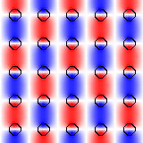
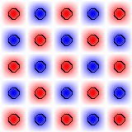
2d periodicity, ε=12:1
E_{z}
(+ 90° rotated version)
E_{z}
Γ
X
M
Γ
E
gap for
n > ~1.75:1
TM
–
+
H

Slide 45
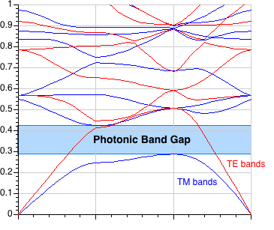
2d periodicity, ε=12:1
a
frequency ω (2πc/a) = a / λ
irreducible Brillouin zone
Γ
X
M
Γ
M
k
E
E
X
TM
TE
Γ
H
H

Slide 46
What a difference a boundary condition makes…
ε₁
ε₂
E|| is continuous:
energy density ε|E|²
more in larger ε
E_{1,||} = E_{2,||}
εE⊥ is continuous:
energy density |εE|²/ε
more in smaller ε
ε₁E_{1,⊥} = ε₂E_{2,⊥}
To get strong confinement & gaps,
want E mostly parallel to interfaces
TM: ||
TE: ⊥

Slide 47
2d photonic crystal: TE gap, ε=12:1
TE bands
TM bands
E
TE
H
gap for n > ~1.4:1

Slide 48
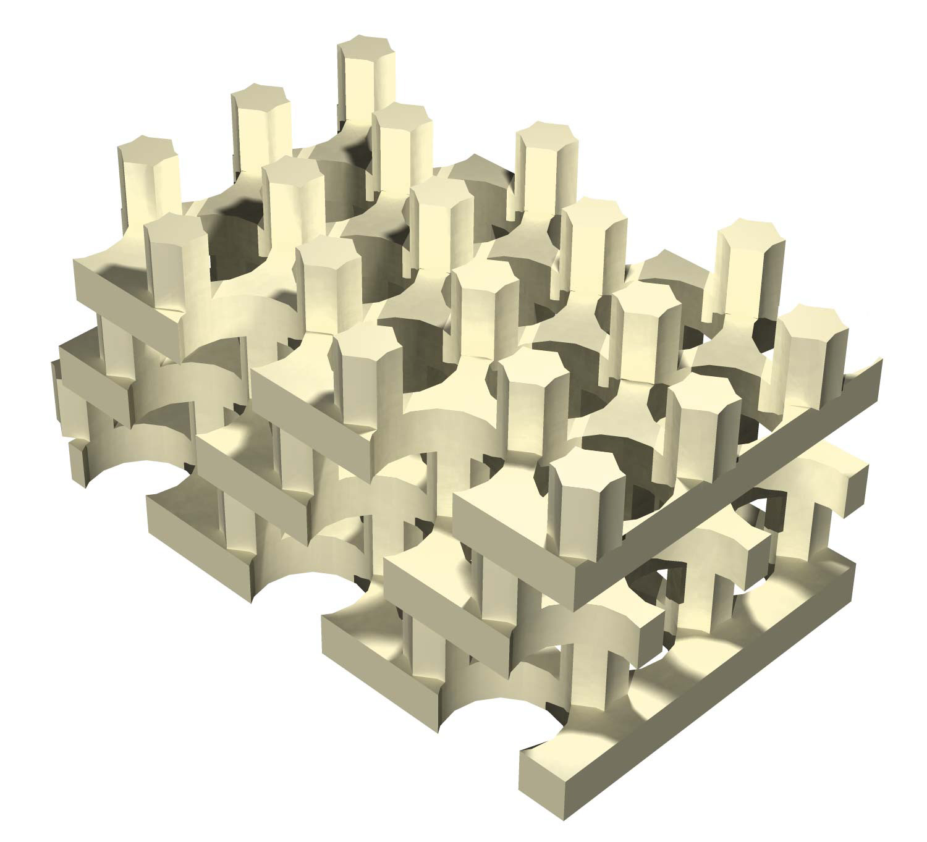
3d photonic crystal: complete gap , ε=12:1
I.
II.
gap for n > ~2:1
[ S. G. Johnson et al., Appl. Phys. Lett. 77, 3490 (2000) ]

Slide 49
You, too, can compute photonic eigenmodes!
MIT Photonic-Bands (MPB) package:
http://ab-initio.mit.edu/mpb

Slide 50
The Mother of (almost) All Bandgaps
The diamond lattice:
fcc (face-centered-cubic)
with two “atoms” per unit cell
(primitive)
Recipe for a complete gap:
fcc = most-spherical Brillouin zone
+ diamond “bonds” = lowest (two) bands can concentrate in lines
Notes:
MPB tutorial, http://ab-initio.mit.edu/mpb
K. M. Ho, C. T. Chan, and C. M. Soukoulis, "Existence of a photonic gap in periodic dielectric structures," Phys. Rev. Lett. 65, 3152 (1990).

Slide 51
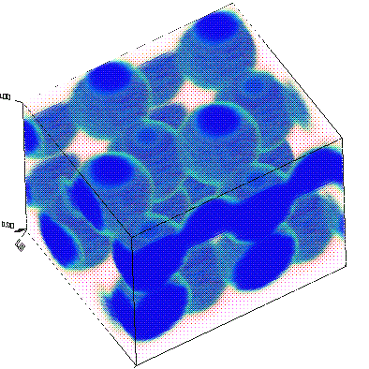
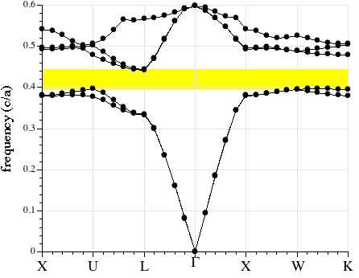
The First 3d Bandgap Structure
K. M. Ho, C. T. Chan, and C. M. Soukoulis, Phys. Rev. Lett. 65, 3152 (1990).
11% gap
frequency (c/a)
for gap at λ = 1.55µm,
sphere diameter ~ 330nm
overlapping Si spheres
MPB tutorial, http://ab-initio.mit.edu/mpb
Notes:
MPB tutorial, http://ab-initio.mit.edu/mpb
K. M. Ho, C. T. Chan, and C. M. Soukoulis, "Existence of a photonic gap in periodic dielectric structures," Phys. Rev. Lett. 65, 3152 (1990).

Slide 52
Layer-by-Layer Lithography
• Fabrication of 2d patterns in Si or GaAs is very advanced
(think: Pentium IV, 50 million transistors)
…inter-layer alignment techniques are only slightly more exotic
So, make 3d structure one layer at a time
Need a 3d crystal with constant cross-section layers

Slide 53
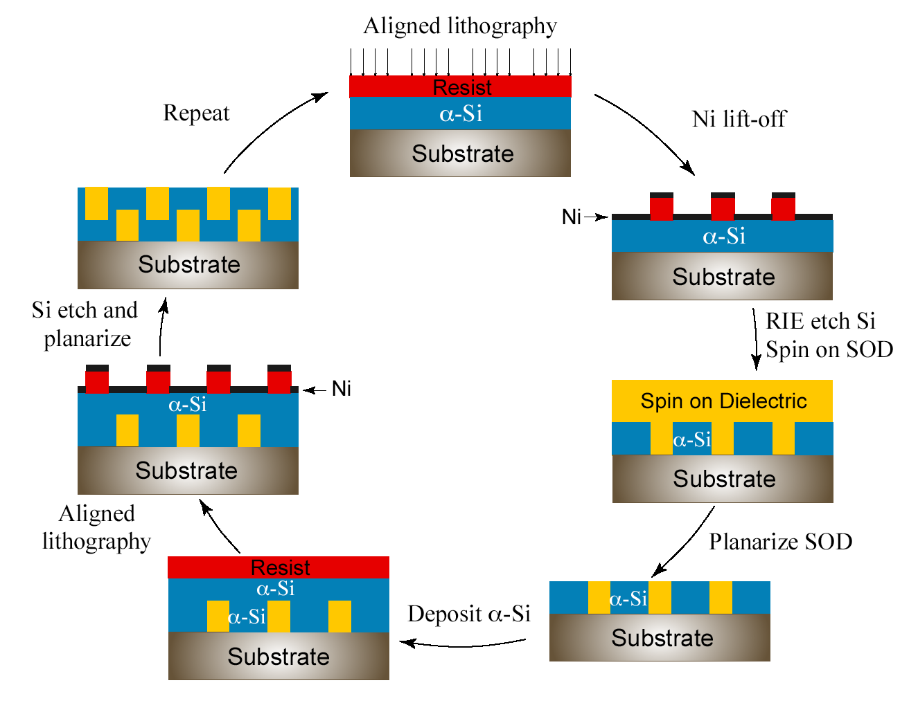
A Schematic
[ M. Qi, H. Smith, MIT ]

Slide 54
Making Rods & Holes Simultaneously
side view
s
u
b
s
t
r
a
t
e
Si
top view

Slide 55
Making Rods & Holes Simultaneously
expose/etch
holes
A
A
A
A
s
u
b
s
t
r
a
t
e
A
A
A
A
A
A
A
A
A
A
A
A
A
A
A
A
A
A
A
A
A

Slide 56
Making Rods & Holes Simultaneously
backfill with
silica (SiO₂)
& polish
A
A
A
A
s
u
b
s
t
r
a
t
e
A
A
A
A
A
A
A
A
A
A
A
A
A
A
A
A
A
A
A
A
A

Slide 57
Making Rods & Holes Simultaneously
deposit another
Si layer
l
a
y
e
r
1
A
A
A
A
s
u
b
s
t
r
a
t
e
A
A
A
A
A
A
A
A
A
A
A
A
A
A
A
A
A
A
A
A
A

Slide 58
Making Rods & Holes Simultaneously
dig more holes
offset
& overlapping
l
a
y
e
r
1
B
B
B
B
A
A
A
A
s
u
b
s
t
r
a
t
e
A
B
A
B
A
B
A
B
A
B
A
B
A
B
A
B
A
B
A
B
A
B
A
B
A
B
A
B
A
B
A
B
A
B
A
B
A
B
A
B
A
B

Slide 59
Making Rods & Holes Simultaneously
backfill
l
a
y
e
r
1
B
B
B
B
A
A
A
A
s
u
b
s
t
r
a
t
e
A
B
A
B
A
B
A
B
A
B
A
B
A
B
A
B
A
B
A
B
A
B
A
B
A
B
A
B
A
B
A
B
A
B
A
B
A
B
A
B
A
B

Slide 60
Making Rods & Holes Simultaneously
etcetera
(dissolve
silica
when
done)
A
l
a
y
e
r
3
A
A
A
one
period
C
l
a
y
e
r
2
C
C
C
l
a
y
e
r
1
B
B
B
B
A
A
A
A
s
u
b
s
t
r
a
t
e
C
A
B
C
A
B
C
A
B
C
A
B
C
A
B
C
A
B
C
A
B
C
C
A
B
C
A
B
C
A
B
C
A
B
C
A
B
C
A
B
C
A
B
C
C
A
B
C
A
B
C
A
B
C
A
B
C
A
B
C
A
B
C
A
B
C

Slide 61
Making Rods & Holes Simultaneously
etcetera
A
l
a
y
e
r
3
A
A
A
one
period
C
l
a
y
e
r
2
C
C
C
l
a
y
e
r
1
B
B
B
B
hole layers
A
A
A
A
s
u
b
s
t
r
a
t
e
C
A
B
C
A
B
C
A
B
C
A
B
C
A
B
C
A
B
C
A
B
C
C
A
B
C
A
B
C
A
B
C
A
B
C
A
B
C
A
B
C
A
B
C
C
A
B
C
A
B
C
A
B
C
A
B
C
A
B
C
A
B
C
A
B
C

Slide 62
Making Rods & Holes Simultaneously
etcetera
A
l
a
y
e
r
3
A
A
A
one
period
C
l
a
y
e
r
2
C
C
C
l
a
y
e
r
1
B
B
B
B
rod layers
A
A
A
A
s
u
b
s
t
r
a
t
e
C
A
B
C
A
B
C
A
B
C
A
B
C
A
B
C
A
B
C
A
B
C
C
A
B
C
A
B
C
A
B
C
A
B
C
A
B
C
A
B
C
A
B
C
C
A
B
C
A
B
C
A
B
C
A
B
C
A
B
C
A
B
C
A
B
C

Slide 63
7-layer E-Beam Fabrication
[ M. Qi, et al., Nature 429, 538 (2004) ]
Notes:
Point out 60nm veins
30nm inter-layer alignment

Slide 64
Supercontinuum-Source vs. Theoretical Transmission Spectra
[ M. Qi, H. Smith, MIT ]
Notes:
Wide band gap (pseudogap for normal incidence)
Ripples from Fabry-Perot

Slide 65
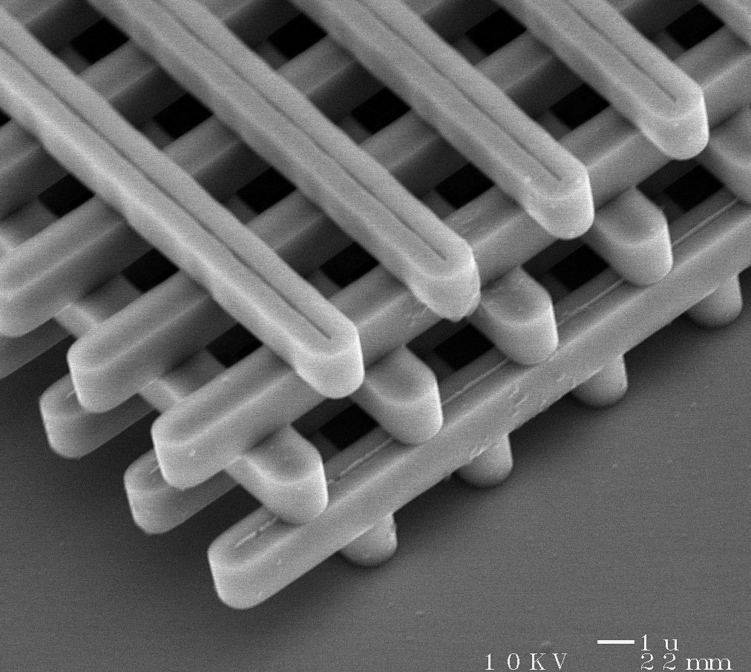
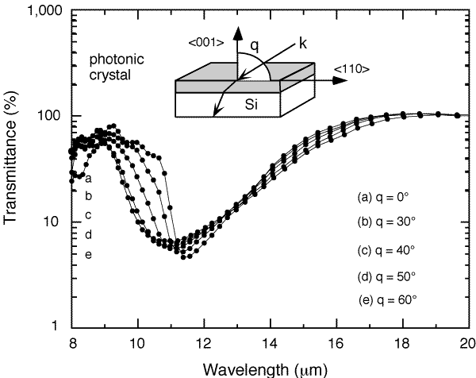
The Woodpile Crystal
an earlier design:
(& currently more popular)
[ K. Ho et al., Solid State Comm. 89, 413 (1994) ]
[ H. S. Sözüer et al., J. Mod. Opt. 41, 231 (1994) ]
(4 “log” layers = 1 period)
[ S. Y. Lin et al., Nature 394, 251 (1998) ]
Si
gap
http://www.sandia.gov/media/photonic.htm
Notes:
S. Y. LIN et al., Nature 394, 251 - 253 (1998)
The vertical topology of the 3D lattice structure is built by the repetitive deposition and etching of multiple dielectric films. To accomplish this goal, a comprehensive five-level stacking process was developed. Within each layer, SiO2 was first deposited, patterned, and etched to the desired depth. The resulting trenches were then filled with polycrystalline silicon. Following this, the surface of the wafers were made flat using chemical mechanical polishing11, and the process was then repeated. After the five-level process was completed, the wafer was immersed in a HF/water solution for the final SiO2 removal. Figure 2a shows a scanning electron micrograph (SEM) top view of a completed four-layer structure. It has an impressive periodicity over an area of (1 cm times 1 cm). The underlying layer structure is also evident. In Fig. 2b, an SEM cross-sectional view of the same 3D photonic crystal is shown. The pitch between adjacent rods is d = 4.2 mum, the rod width is w = 1.2 mum and the layer thickness is 1.6 mum. The smoothness of the planarized surface is controlled to within 1% of the layer thickness across the entire 6-inch wafer. As the preparation of this 3D lattice involves the use of well developed and supported Si integrated-circuit fabrication process, it is suitable for large-scale integration and production.

Slide 66
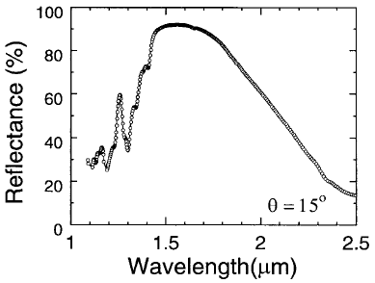
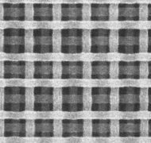
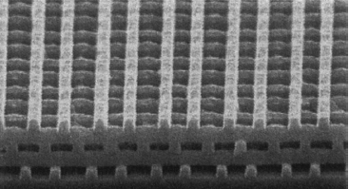
1.25 Periods of Woodpile @ 1.55µm
(4 “log” layers = 1 period)
[ Lin & Fleming, JLT 17, 1944 (1999) ]
Si
gap
180nm
1.3µm
Notes:
S. Y. LIN et al., Nature 394, 251 - 253 (1998)
The vertical topology of the 3D lattice structure is built by the repetitive deposition and etching of multiple dielectric films. To accomplish this goal, a comprehensive five-level stacking process was developed. Within each layer, SiO2 was first deposited, patterned, and etched to the desired depth. The resulting trenches were then filled with polycrystalline silicon. Following this, the surface of the wafers were made flat using chemical mechanical polishing11, and the process was then repeated. After the five-level process was completed, the wafer was immersed in a HF/water solution for the final SiO2 removal. Figure 2a shows a scanning electron micrograph (SEM) top view of a completed four-layer structure. It has an impressive periodicity over an area of (1 cm times 1 cm). The underlying layer structure is also evident. In Fig. 2b, an SEM cross-sectional view of the same 3D photonic crystal is shown. The pitch between adjacent rods is d = 4.2 mum, the rod width is w = 1.2 mum and the layer thickness is 1.6 mum. The smoothness of the planarized surface is controlled to within 1% of the layer thickness across the entire 6-inch wafer. As the preparation of this 3D lattice involves the use of well developed and supported Si integrated-circuit fabrication process, it is suitable for large-scale integration and production.

Slide 67
Two-Photon Lithography
2
hν = ∆E
2-photon probability ~ (light intensity)²
hν
photon
photon
hν
e
E₀
3d Lithography
Atom
lens
…dissolve unchanged stuff
(or vice versa)
some chemistry
(polymerization)

Slide 68
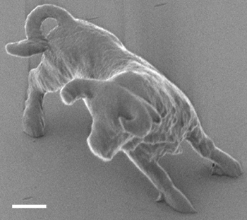
Lithography is a Beast
[ S. Kawata et al., Nature 412, 697 (2001) ]
λ = 780nm
resolution = 150nm
7µm
(3 hours to make)
2µm
Notes:
S. Kawata et al., Nature 412, 697 (2001).
These 10µm-long, 7µm-high bulls are the smallest model animals ever made artificially.
780 nm with a 150-femtosecond pulse width was used as an exposure source. Bull sculpture produced by raster scanning; the process took 180 min.
To depict the tiny features of our microbulls, a fabrication accuracy of about 150 nm was needed, which we achieved by using nonlinear processes of the photochemicalreactions involved. Polymerization occurred only in the vicinity of the focal spot and the size of solidified voxels (three-dimensional volume elements) was reduced because of the quadratic dependence of TPA probability on the photon fluence density. Furthermore, photogenerated radicals in this volume were subject to scavenging by dissolved oxygen molecules, so polymerization reactions were not initiated and propagated if the exposure energy was less than a critical value. This property defined a TPA threshold and excluded the low-intensity lobe (the zero-order edge and the subsidiary maxima of the Airy pattern) from polymerization and thus further reduced the voxel size (Fig. 1g). The diffraction limit imposed by Rayleigh criteria was simply a measure of focal-spot size, and did not put any restraint on the actual size of solidified voxels.
Micro-spring coil diameter is 300nm. Suspended in ethanol. Viscosity-damped.

Slide 69
Holographic Lithography
[ D. N. Sharp et al., Opt. Quant. Elec. 34, 3 (2002) ]
Four beams make 3d-periodic interference pattern
k-vector differences give reciprocal lattice vectors (i.e. periodicity)
absorbing material
(1.4µm)
beam polarizations + amplitudes (8 parameters) give unit cell
Notes:
Photonic crystals for the visible spectrum by holographic lithography
AUTHOR: Sharp,-D.-N.; Campbell,-M.; Dedman,-E.-R.; Harrison,-M.-T.; Denning,-R.-G.; Turberfield,-A.-J.
SOURCE: Optical-and-Quantum-Electronics. Jan.-March 2002; 34(1-3): 3-12
University of Oxford
[ D. N. Sharp et al., Opt. Quant. Elec. 34, 3 (2002) ]
In this article we describe a new holographic process (Campbell et al. 2000) that is intrinsically well adapted to the production of microstructured photonic materials. A 3D laser interference pattern exposes a photosensitive polymer precursor (photoresist) rendering exposed areas insoluble; unexposed areas are dissolved away leaving a 3D photonic crystal formed of cross-linked polymer with air-ҐҐled voids. This process allows ҐҐxible design of the structure of a unit cell and thus of the optical properties of the microstructured material.
We create an interference pattern at the intersection of four non-coplanarbeams from a frequency-tripled, injection-seeded Nd:YAG laser (wavelengthk 1/4 355 nm) (Campbell et al. 2000). Such a pattern has 3D translationalsymmetry; its primitive reciprocal lattice vectors are equal to the diҐҐrencesbetween the wavevectors of the beams. Patterns with any Bravais lattice maybe generated in this way, and interference patterns have been used to createperiodic optical traps for laser-cooled atoms (Grynberg et al. 1993) (we notethat Berger et al. (1997) have independently suggested lithography using 3Dinterference, and that Shoji and Kawata (2000) have used a combination oftwo-dimensional (2D) and one-dimensional patterns to create 3D microstructure).We require a pattern with high intensity contrast that can betranslated into high solubility contrast in the photoresist; we also require theinsoluble polymer to form a connected but open structure. For a particularset of wavevectors, eight parameters describing the intensities and polarizationvectors of the four beams are required to deҐҐe the intensity distributionwithin a unit cell (i.e. the basis of the interference pattern). The eight freebeam parameters give considerable freedom to engineer the content of theunit cell, which in turn determines the photonic band structure (Ho et al.1990; Yablonovitch et al. 1991b).
Fig. 3. (a) SEM image of a fcc polymeric photonic crystal generated by exposure of a 10 µm film ofphotoresist to the interference pattern shown in Fig. 2(a). The top surface is a (111) plane; the film hasbeen fractured along (111) cleavage planes of the photonic crystal structure. Scale bar, 10 µm. (b) Close-upof (111) surface and {111} cleavage planes. Scale bar, 5 µm. (c) Simulation of (b) formed by cutting aconstant-intensity surface along narrow bonds. (d) Close-up of a (111) surface. Scale bar, 1 µm. (e) Titaniaphotonic crystal with higher refractive index contrast produced by using the polymeric structure as atemplate. The surface is slightly tilted from the (111) plane. Scale bar, 1 µm.

Slide 70
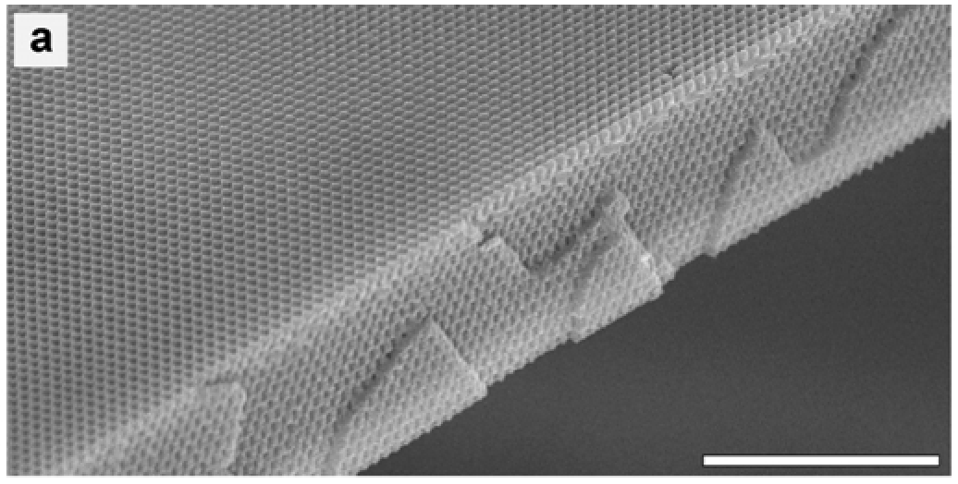
One-Photon
Holographic Lithography
[ D. N. Sharp et al., Opt. Quant. Elec. 34, 3 (2002) ]
10µm
huge volumes, long-range periodic, fcc lattice…backfill for high contrast
Notes:
Photonic crystals for the visible spectrum by holographic lithography
AUTHOR: Sharp,-D.-N.; Campbell,-M.; Dedman,-E.-R.; Harrison,-M.-T.; Denning,-R.-G.; Turberfield,-A.-J.
SOURCE: Optical-and-Quantum-Electronics. Jan.-March 2002; 34(1-3): 3-12
University of Oxford
[ D. N. Sharp et al., Opt. Quant. Elec. 34, 3 (2002) ]
In this article we describe a new holographic process (Campbell et al. 2000) that is intrinsically well adapted to the production of microstructured photonic materials. A 3D laser interference pattern exposes a photosensitive polymer precursor (photoresist) rendering exposed areas insoluble; unexposed areas are dissolved away leaving a 3D photonic crystal formed of cross-linked polymer with air-ҐҐled voids. This process allows ҐҐxible design of the structure of a unit cell and thus of the optical properties of the microstructured material.
We create an interference pattern at the intersection of four non-coplanarbeams from a frequency-tripled, injection-seeded Nd:YAG laser (wavelengthk 1/4 355 nm) (Campbell et al. 2000). Such a pattern has 3D translationalsymmetry; its primitive reciprocal lattice vectors are equal to the diҐҐrencesbetween the wavevectors of the beams. Patterns with any Bravais lattice maybe generated in this way, and interference patterns have been used to createperiodic optical traps for laser-cooled atoms (Grynberg et al. 1993) (we notethat Berger et al. (1997) have independently suggested lithography using 3Dinterference, and that Shoji and Kawata (2000) have used a combination oftwo-dimensional (2D) and one-dimensional patterns to create 3D microstructure).We require a pattern with high intensity contrast that can betranslated into high solubility contrast in the photoresist; we also require theinsoluble polymer to form a connected but open structure. For a particularset of wavevectors, eight parameters describing the intensities and polarizationvectors of the four beams are required to deҐҐe the intensity distributionwithin a unit cell (i.e. the basis of the interference pattern). The eight freebeam parameters give considerable freedom to engineer the content of theunit cell, which in turn determines the photonic band structure (Ho et al.1990; Yablonovitch et al. 1991b).
Fig. 3. (a) SEM image of a fcc polymeric photonic crystal generated by exposure of a 10 µm film ofphotoresist to the interference pattern shown in Fig. 2(a). The top surface is a (111) plane; the film hasbeen fractured along (111) cleavage planes of the photonic crystal structure. Scale bar, 10 µm. (b) Close-upof (111) surface and {111} cleavage planes. Scale bar, 5 µm. (c) Simulation of (b) formed by cutting aconstant-intensity surface along narrow bonds. (d) Close-up of a (111) surface. Scale bar, 1 µm. (e) Titaniaphotonic crystal with higher refractive index contrast produced by using the polymeric structure as atemplate. The surface is slightly tilted from the (111) plane. Scale bar, 1 µm.

Slide 71
Mass-production II: Colloids
(evaporate)
silica (SiO₂)
microspheres (diameter < 1µm)
sediment by gravity into
close-packed fcc lattice!
Notes:
On creating nanoparticles, from: http://www.icmm.csic.es/cefe/
The quality of the opaline structure dramatically depends on the monodispersity of the starting particles. So, the first requirement in order to build technologically interesting materials is to control the production of well-shaped size-controlled spherical silica particles. The synthesis of submicron silica particles has been extensively studied (1, 2). The most common method is that developed by Stöber et al.(3). It consists of a sol-gel process [sol-gel = colloidal suspension of silica particles that is gelled to form a solid] in which a Si metal-organic compound hydrolyses whereby Si-O chains are created and whose condensation leads to amorphous silica nanoparticles. Under controlled reaction conditions monodispersed spheres (less than 5% in dispersion) with diameters in the range between tenths of a micron and a micron can be produced. The figure shows a diagram of the chemical process along with transmission electron microscopy (TEM) images of the resulting silica particles.
3.- W. Stöber, A. Fink, and E. Bohn.1968. J. Colloid Interface Sci., 26, 62.

Slide 72
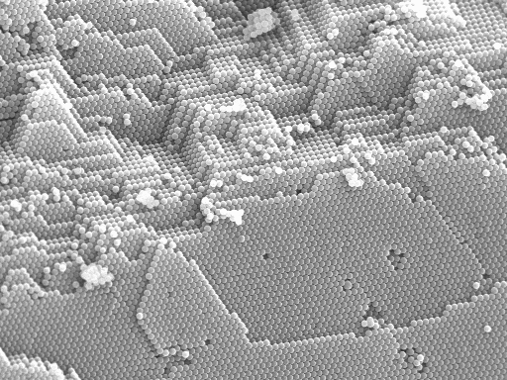
Mass-production II: Colloids
http://www.icmm.csic.es/cefe/

Slide 73
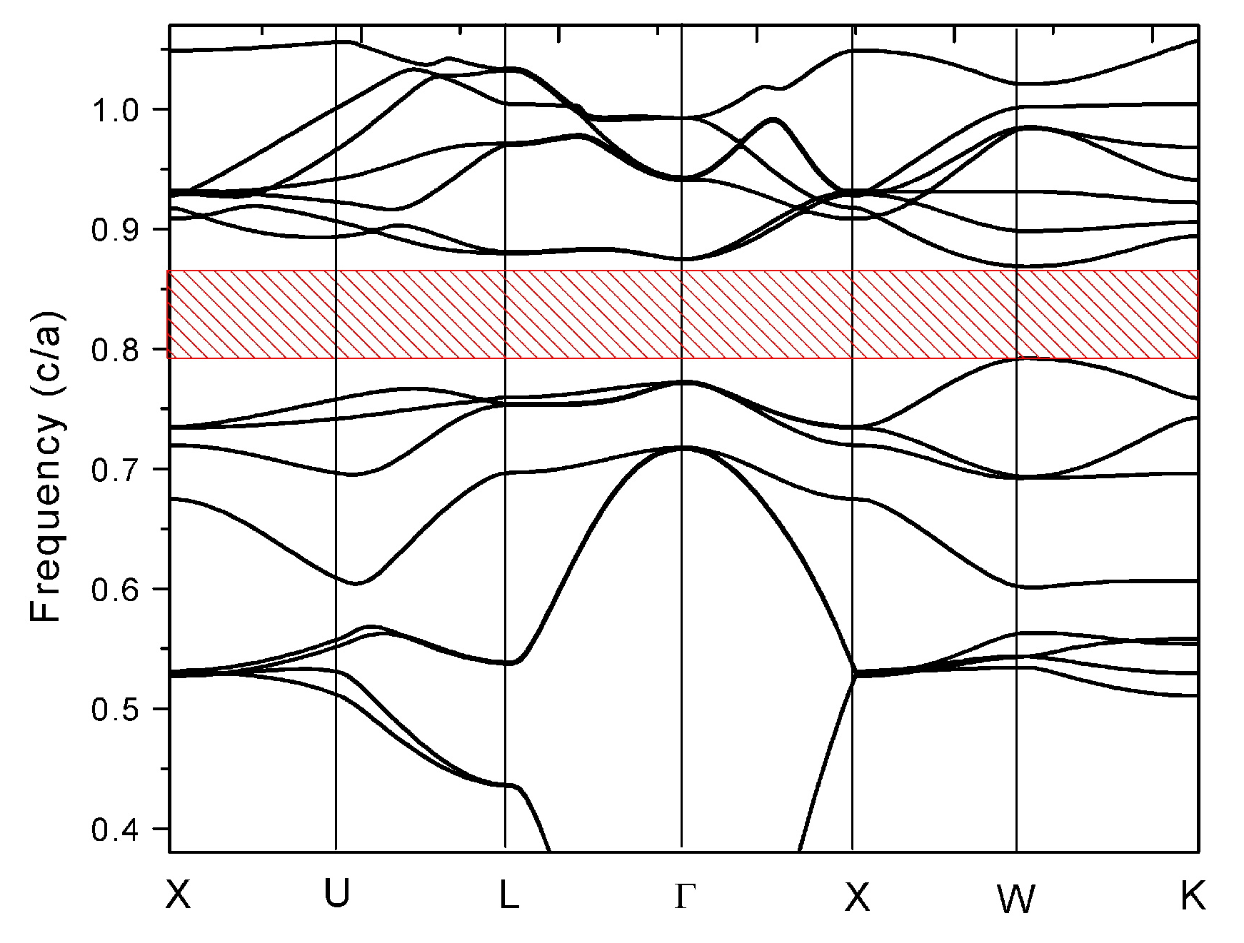
Inverse Opals
[ figs courtesy
D. Norris, UMN ]
[ H. S. Sözüer, PRB 45, 13962 (1992) ]
fcc solid spheres do not have a gap…
…but fcc spherical holes in Si do have a gap
sub-micron colloidal spheres
Template
(synthetic opal)
3D
Infiltration
complete band gap
Remove Template
~ 10% gap between 8th & 9th bands
small gap, upper bands: sensitive to disorder
“Inverted Opal”

Slide 74
In Order To Form a More Perfect Crystal…
[ figs courtesy
D. Norris, UMN ]
meniscus
1 micron
silica spheres
in ethanol
65C
silica
250nm
evaporate
solvent
80C
Convective Assembly
[ Nagayama, Velev, et al., Nature (1993)
Colvin et al., Chem. Mater. (1999) ]
Heat Source
Capillary forces during drying cause assembly in the meniscus
Extremely flat, large-area opals of controllable thickness

Slide 75
A Better Opal
[ fig courtesy
D. Norris, UMN ]

Slide 76
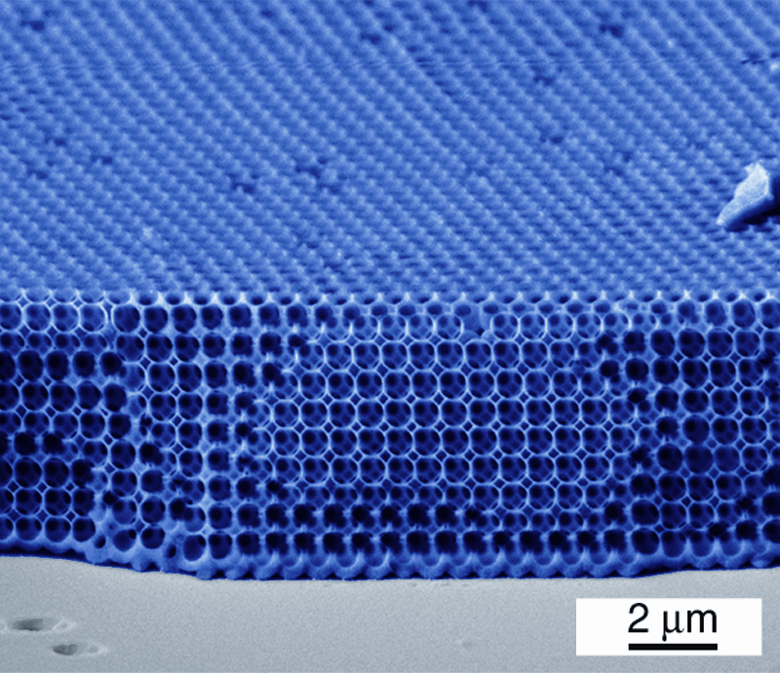
Inverse-Opal Photonic Crystal
[ fig courtesy
D. Norris, UMN ]
[ Y. A. Vlasov et al., Nature 414, 289 (2001). ]

Slide 77
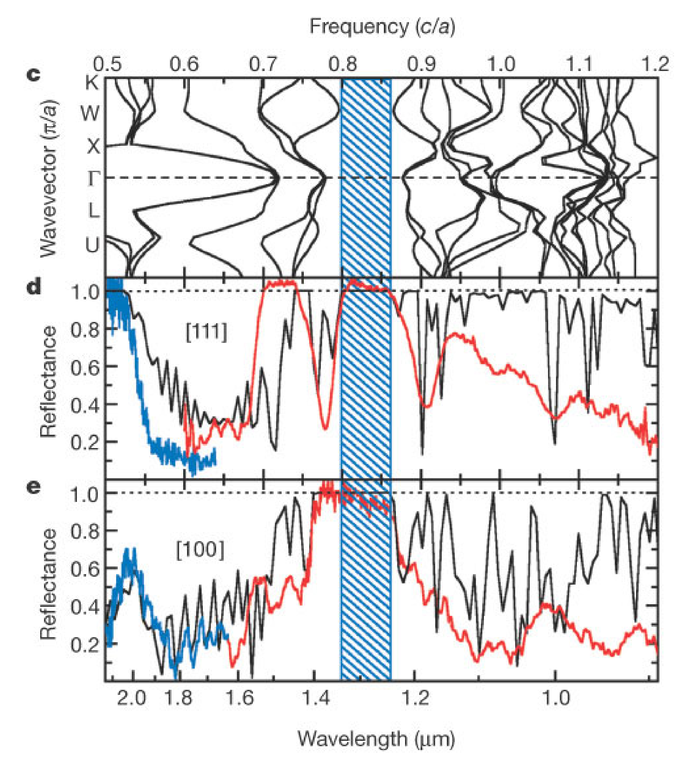
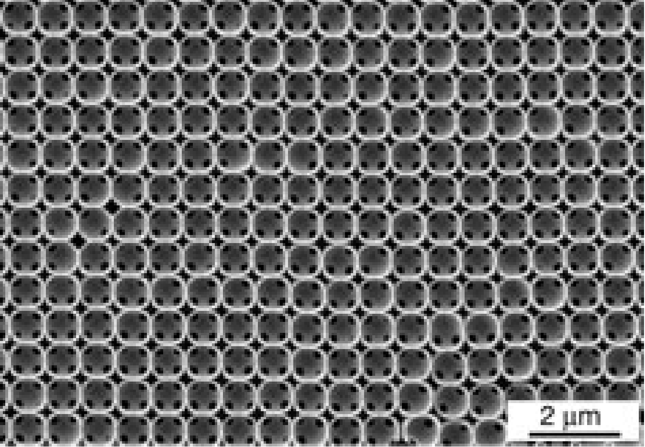
Inverse-Opal Band Gap
good agreement
between theory (black)
& experiment (red/blue)
[ Y. A. Vlasov et al., Nature 414, 289 (2001). ]
Notes:
On-chip natural assembly of silicon photonic bandgap crystals
AUTHOR: Vlasov,-Y.-A.; Xiang-Zheng-Bo; Sturm,-J.-C.; Norris,-D.-J.
SOURCE: Nature-. 15 Nov. 2001; 414(6861): 289-93
[ Y. A. Vlasov et al., Nature 414, 289 (2001). ]
Comparison of optical results with calculations. a, Experimental (red) and calculated (black) transmission spectra for incidence normal to the (111) plane of a 7-layer planar opal made from 855-nm silica spheres with a refractive index of 1.45. The frequency is plotted in units of c/a, where c is the speed of light and a is the lattice constant. b, The photonic band diagram calculated along the [111] direction for the same parameters used in a. c, The photonic band diagram calculated for the Si inverted opal measured in d and e. d, Experimental reflection spectra for amorphous Si inverted opals measured normal to the (111) plane. Data from two samples, with a equal to 1,070 nm (red) and 841 nm (blue), are combined. The wavelength scale corresponds to the 1,070-nm sample. The best theoretical fit (black) was obtained for a Si coating sphere radius of 0.428 and an air sphere radius of 0.354. e, Experimental and theoretical reflection spectra as in d for incidence normal to the (100) plane. The blue-hatched region denotes the expected frequency range of the bandgap. For calculations, we used 12.25 as the dielectric constant of Si.
However the standard method for growing the initial opal (sedimentation of spheres from suspension) yields centimetre-scale pieces of polycrystalline material with numerous defects in the crystal lattice (stacking faults, dislocations and point defects). As the bandgap in f.c.c. photonic crystals is relatively narrow, these defects can easily close the gap by filling it with localized photonic states16.
We used an alternative method to form synthetic opals. Recent research has improved control over colloidal crystallization in various geometries20-22. In particular, strong capillary forces at a meniscus between a substrate and a colloidal sol can induce crystallization of spheres into a 3D array of controllable thickness22. If this meniscus is slowly swept across a vertically placed substrate by solvent evaporation, thin planar opals can be deposited. As solvent evaporation must compete with sedimentation, this method is believed to be limited to spheres with diameters <0.4 µm. But spheres with larger diameters (0.8 µm) are required to make photonic crystals with a bandgap at technologically important wavelengths such as 1.3 or 1.5 µm (ref. 19), so we added a convective flow to the sol to minimize sedimentation and provide a continuous flow of particles toward the meniscus region. We found straightforward conditions that yielded planar opals using large (up to 1 µm) silica colloids. For example, a Si wafer was placed vertically in a vial containing an ethanolic suspension of silica spheres (855 1.3% in size, 1% by volume). Flow was achieved by placing a temperature gradient across the vial (from 80 °C at the bottom to 65 °C near the top). Scanning electron microscopy (SEM) images of the resulting templates (Fig. 1a) indicate that the defect densities (1% stacking faults, 10-3 point defects per unit cell) are much lower than for sedimented opals (20% stacking faults, 10-2 point defects per unit cell16). In addition, this approach yields large-sphere opals up to 20 layers thick that coat centimetre-scale areas of the Si wafer (Fig. 1b). SEM and optical diffraction measurements (Fig. 1c) show that these opals have single crystalline domains (1 mm–1 cm) that are 10–100 times larger than in the best sedimented opals. We speculate that the improved quality of these samples is due to a meniscus-induced shear that aligns the close-packed layers into a f.c.c. crystal during deposition, as shown in other geometries23.
Once such a template was prepared, its interstitial spaces were filled with Si to satisfy the refractive index requirement for the photonic bandgap. In previous work, a purpose-built apparatus was required, in which disilane was first condensed into the pores of the opal at cryogenic temperatures and subsequently decomposed by heating at pressures of 200 torr (ref. 15). Although homogeneous infiltration was demonstrated for sedimented opals, this process did not allow sufficient control over the deposition to fill our thin planar opals. Instead, we filled planar opals using a commercially available low-pressure chemical vapour deposition (LPCVD) furnace that provides complete control of the growth parameters24. As LPCVD is surface-reaction-limited, this technique is in principle well suited to conformal filling of the interstitials of the opal. Furthermore, an advantage of LPCVD is that it is the standard Si deposition technique for the microelectronics industry (used, for example, in complementary metal-oxide-semiconductor, CMOS, technology). Unfortunately, under typical CMOS fabrication conditions near 600 °C, filling the opal template can be problematic. First, infiltration of the structure can be limited by premature obstruction of the outermost channels (100 nm) of the opal, which provide gas transport to the innermost layers. Second, deposition results in polycrystalline silicon (poly-Si) with grains (100 nm) that can introduce undesirable roughness at surfaces inside the final photonic crystal. By decreasing the temperature to 550 °C, we obtained homogeneous infiltration with LPCVD even for templates as thick as 40 layers. The lower temperature reduced the sticking coefficient of the precursor, allowing deposition to penetrate all the way to the Si wafer without a visible interface (Fig. 2a). Temperatures below 580 °C also avoided internal surface roughness by uniformly depositing amorphous silicon (a-Si), which was then transformed into a poly-Si structure with smooth interfaces by annealing at 600 °C for 8 hours. After deposition, the silica template was removed by wet etching. Thus thin planar inverted opals of controllable thickness were obtained (Fig. 2a–d) that were incorporated directly into the wafer and inherited the advantageous mechanical properties of poly-Si.

Slide 78
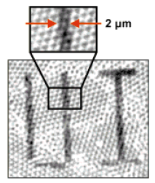
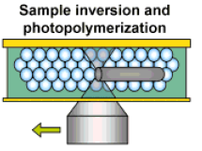
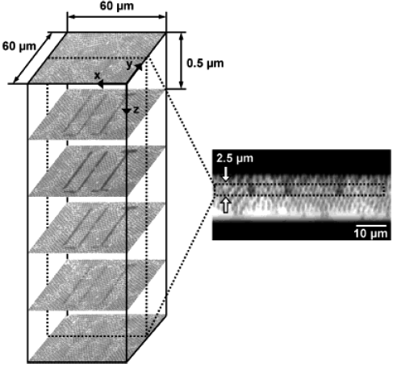
Inserting Defects in Inverse Opals e.g., Waveguides
Three-photon lithography
with
laser scanning
confocal microscope
(LSCM)
[ Wonmok,
Adv. Materials 14, 271 (2002) ]

Slide 79
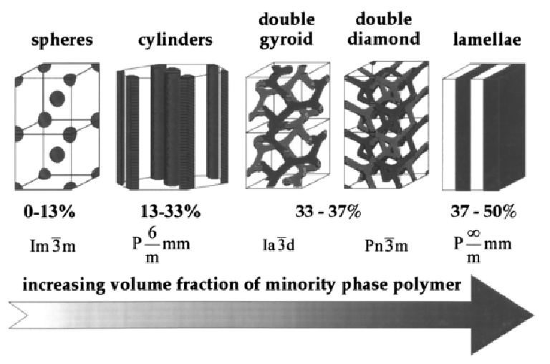
Mass-Production III:
Block (not Bloch) Copolymers
two polymers
can segregate,
ordering into periodic arrays
periodicity ~
polymer block size
~ 50nm
(possibly bigger)
[ Y. Fink, A. M. Urbas, M. G. Bawendi, J. D. Joannopoulos, E. L. Thomas, J. Lightwave Tech. 17, 1963 (1999) ]

Slide 80
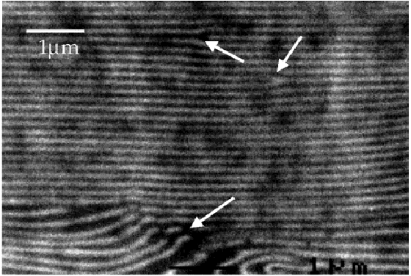
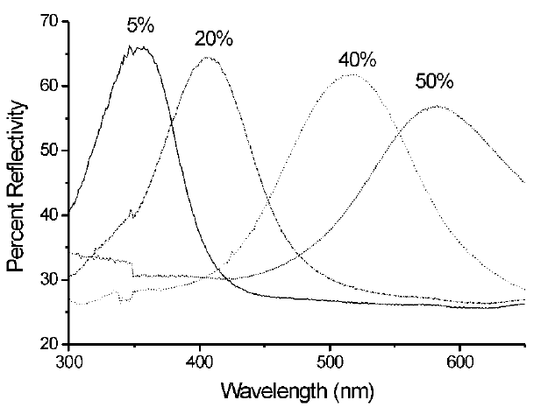
Block-Copolymer 1d Visible Bandgap
/ homopolymer
Flexible material:
bandgap can be
shifted by stretching it!
reflection for differing homopolymer %
dark/light:
polystyrene/polyisoprene
n = 1.59/1.51
[ A. Urbas et al., Advanced Materials 12, 812 (2000) ]

Slide 81
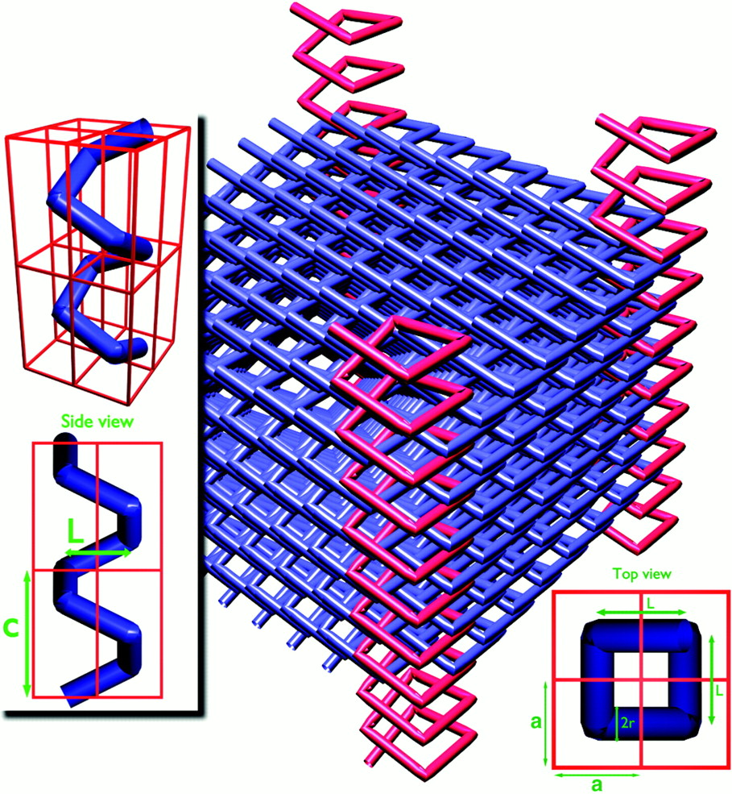
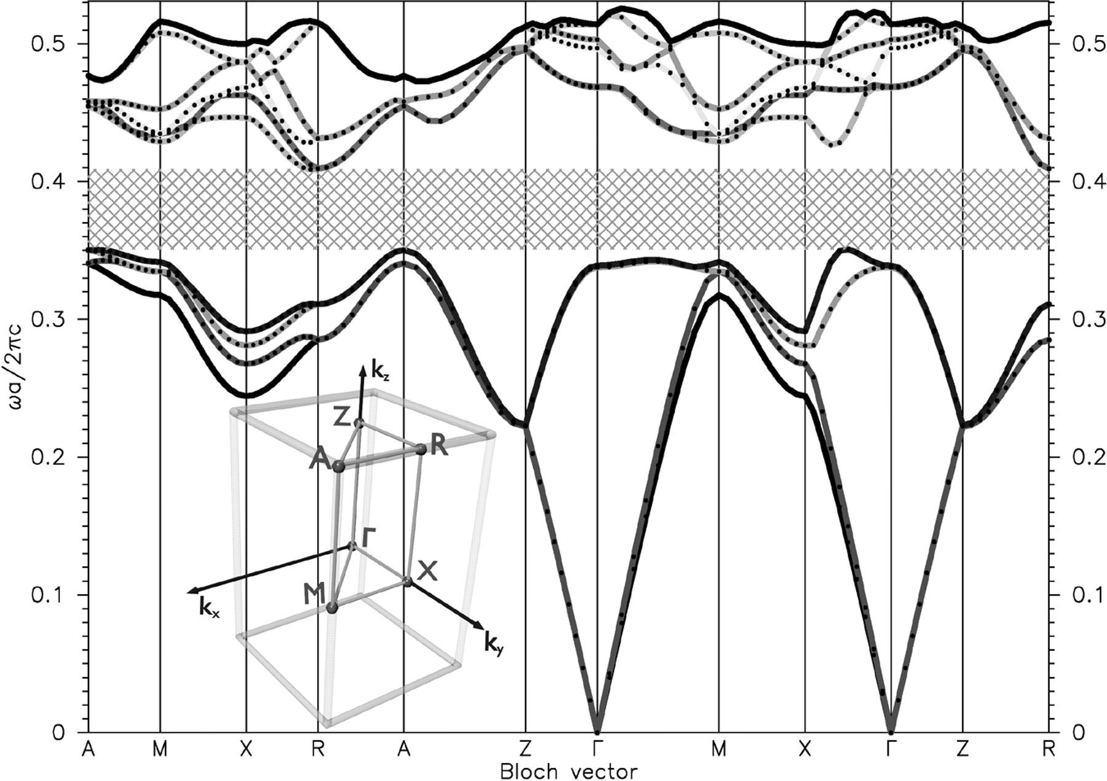
Be GLAD: Even more crystals!
“GLAD” = “GLancing Angle Deposition”
15% gap for Si/air
diamond-like
with “broken bonds”
doubled unit cell, so gap between 4th & 5th bands
[ O. Toader and S. John, Science 292, 1133 (2001) ]

Slide 82
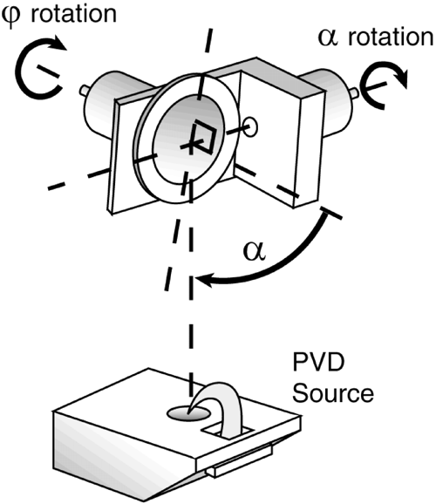
Glancing Angle Deposition
“seed” posts
glancing-angle Si
only builds up
on protrusions
…rotate to
spiral
evaporated
Si
Si
[ S. R. Kennedy et al., Nano Letters 2, 59 (2002) ]
Notes:
color image: O. Toader and S. John, Science 292, 1133 (2001)
Band structure for the direct structure crystal characterized by … fspiral = 30%. The lengths are given in units of a, the lattice constant. The width of the PBG is 15.2% relative to the center frequency for epsilon b = 1 and epsilon s = 11.9. The positions of high symmetry points are illustrated in the inset.
optimized inverse structures can have up to 27% gaps
S. R. Kennedy et al., Nano Letters, 2, 59 -62, 2002
The GLAD process provides a simple, versatile means of producing large, three-dimensional band gap photonic crystals in a single processing step on a wide variety of elementary, prepatterned wafers. The principle of this technique lies in the deposition of highly porous films at extreme incidence angles (Figure 1). At these oblique angles, , self-shadowing occurs in the initial nucleation stage where only the higher regions are seen by incoming flux, and further growth is prevented from occurring in other areas. The orientation of the substrate is controlled by two stepper motors and implemented by computer software in conjunction with deposition rate feedback from a crystal thickness monitor. By rotating the substrate appropriately, it is possible to control the growth and shape of the individual structures as they "reach" toward the incoming flux.
To produce square spiral photonic crystal structures, physical vapor deposition is used in a high vacuum chamber with an electron beam source. Structures can be made from a wide range of materials; however, because of the requirement for a material with a large index of refraction, pure silicon with its favorable optical and deposition properties is most commonly chosen. Alternatively, silica may be used to create a template for an inverse square spiral photonic crystal. The substrate is mounted relative to the source, as shown in the schematic of Figure 1, where the throw distance between the source and substrate is greater than 30 cm so that flux reaching the substrate is collimated.
In traditional GLAD on a planar substrate, the location of growths is random, as determined by the impingement of initial flux and subsequent nucleation on the substrate. The result is not considered a periodic arrangement and as such it is necessary to seed the substrate and confine growths to predetermined, regular locations. To meet this requirement, shadowing is used by forming a regular array of areas on the substrate that are higher than surrounding regions.12 The substrate is held at a constant angle of incidence of 80-90 from the normal, and at these angles only the regions with higher relief are seen by the incoming flux. Growth is restricted to these locations and self-shadowing of the structures maintains the restriction on growth throughout the deposition.13

Slide 83
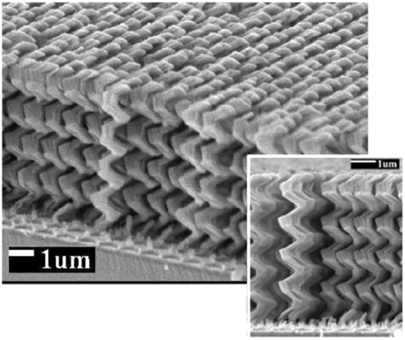
An Early GLAD Crystal
[ S. R. Kennedy et al., Nano Letters 2, 59 (2002) ]
Notes:
color image: O. Toader and S. John, Science 292, 1133 (2001)
Band structure for the direct structure crystal characterized by … fspiral = 30%. The lengths are given in units of a, the lattice constant. The width of the PBG is 15.2% relative to the center frequency for epsilon b = 1 and epsilon s = 11.9. The positions of high symmetry points are illustrated in the inset.
optimized inverse structures can have up to 27% gaps
S. R. Kennedy et al., Nano Letters, 2, 59 -62, 2002
The GLAD process provides a simple, versatile means of producing large, three-dimensional band gap photonic crystals in a single processing step on a wide variety of elementary, prepatterned wafers. The principle of this technique lies in the deposition of highly porous films at extreme incidence angles (Figure 1). At these oblique angles, , self-shadowing occurs in the initial nucleation stage where only the higher regions are seen by incoming flux, and further growth is prevented from occurring in other areas. The orientation of the substrate is controlled by two stepper motors and implemented by computer software in conjunction with deposition rate feedback from a crystal thickness monitor. By rotating the substrate appropriately, it is possible to control the growth and shape of the individual structures as they "reach" toward the incoming flux.
To produce square spiral photonic crystal structures, physical vapor deposition is used in a high vacuum chamber with an electron beam source. Structures can be made from a wide range of materials; however, because of the requirement for a material with a large index of refraction, pure silicon with its favorable optical and deposition properties is most commonly chosen. Alternatively, silica may be used to create a template for an inverse square spiral photonic crystal. The substrate is mounted relative to the source, as shown in the schematic of Figure 1, where the throw distance between the source and substrate is greater than 30 cm so that flux reaching the substrate is collimated.
In traditional GLAD on a planar substrate, the location of growths is random, as determined by the impingement of initial flux and subsequent nucleation on the substrate. The result is not considered a periodic arrangement and as such it is necessary to seed the substrate and confine growths to predetermined, regular locations. To meet this requirement, shadowing is used by forming a regular array of areas on the substrate that are higher than surrounding regions.12 The substrate is held at a constant angle of incidence of 80-90 from the normal, and at these angles only the regions with higher relief are seen by the incoming flux. Growth is restricted to these locations and self-shadowing of the structures maintains the restriction on growth throughout the deposition.13

Slide 84
Outline
Preliminaries: waves in periodic media
Photonic crystals in theory and practice
Bulk crystal properties
Intentional defects and devices
Index-guiding and incomplete gaps
Photonic-crystal fibers
Perturbations, tuning, and disorder

Slide 85
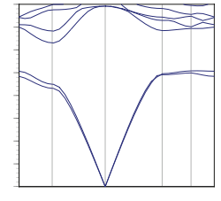
Properties of Bulk Crystals
by Bloch’s theorem
band diagram (dispersion relation)
(cartoon)
backwards slope:
negative refraction
photonic band gap
conserved frequency ω
dω/dk ≈ 0: slow light
(e.g. DFB lasers)
synthetic medium
for propagation
strong curvature:
super-prisms, …
(+ negative refraction)
conserved wavevector k

Slide 86
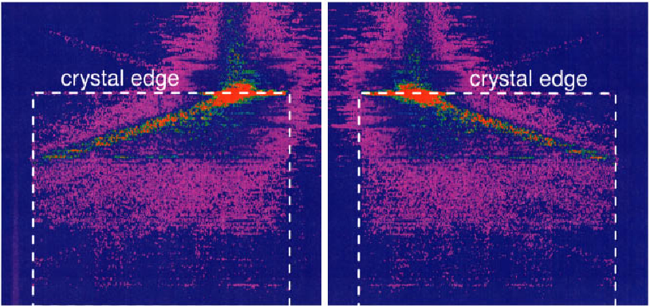

Superprisms
from divergent dispersion (band curvature)
[Kosaka, PRB 58, R10096 (1998).]

Slide 87
Photonic Crystals
& Metamaterials
band diagram (dispersion relation)
(cartoon)
at small ω
(long wavelengths λ >> a)
ω(k) ~ straight line
~ effectively homogeneous material
= metamaterials
photonic band gap
conserved frequency ω
synthetic medium
for propagation
conserved wavevector k

Slide 88



Microwave negative refraction
[ D. R. Smith, J. B. Pendry, M. C. K. Wiltshire, Science 305, 788 (2004) ]
negative refraction
1 cm
superlensing
Magnetic (ring) + Electric (strip) resonances

Slide 89

Negative Indices & Refraction
[ Veselago, 1968
negative ε, μ ]
opposite of ordinary lens:
only images close objects
does not require
curved lens
can exceed classical
diffraction limit

Slide 90

Negative-refractive all-dielectric photonic crystals
negative refraction
focussing
(2d rods in air, TE)
[ M. Notomi, PRB 62, 10696 (2000). ]
not metamaterials: wavelength ~ a,
no homogeneous material can reproduce all behaviors

Slide 91


Superlensing with Photonic Crystals
[ Luo et al, PRB 68, 045115 (2003). ]
2/3 diffraction limit

Slide 92



Negative Refraction and wavevector diagrams
[ Luo et al, PRB 65, 2001104 (2002). ]
ω contours
in (k_{x},k_{y}) space
k|| is conserved

Slide 93


Super-lensing
[Luo, PRB 68, 045115 (2003).]
image
Classical diffraction limit comes from
loss of evanescent waves
… can be recovered by
resonant coupling to surface states
2/3 diffraction limit
(needs band gap)

Slide 94
the magic of periodicity: unusual dispersion without scattering

Slide 95
Outline
Preliminaries: waves in periodic media
Photonic crystals in theory and practice
Bulk crystal properties
Intentional defects and devices
Index-guiding and incomplete gaps
Photonic-crystal fibers
Perturbations, tuning, and disorder

Slide 96
Intentional “defects” are good
microcavities
waveguides (“wires”)

Slide 97




Resonance
an oscillating mode trapped for a long time in some volume
(of light, sound, …)
frequency ω₀
lifetime τ >> 2π/ω₀
quality factor Q = ω₀τ/2
energy ~ e^{–ω0τ/Q}
modal
volume V
[ Notomi et al. (2005). ]
[ C.-W. Wong,
APL 84, 1242 (2004). ]
[ Schliesser et al.,
PRL 97, 243905 (2006) ]
420 nm
[ Eichenfield et al. Nature Photonics 1, 416 (2007) ]

Slide 98
Why Resonance?
an oscillating mode trapped for a long time in some volume
• long time = narrow bandwidth … filters (WDM, etc.)
— 1/Q = fractional bandwidth
• resonant processes allow one to “impedance match”
hard-to-couple inputs/outputs
• long time, small V … enhanced wave/matter interaction
— lasers, nonlinear optics, opto-mechanical coupling,
sensors, LEDs, thermal sources, …

Slide 99





How Resonance?
need mechanism to trap light for long time
metallic cavities:
good for microwave,
dissipative for infrared
[ Xu & Lipson
(2005) ]
10µm
VCSEL
[fotonik.dtu.dk]
ring/disc/sphere resonators:
a waveguide bent in circle,
bending loss ~ exp(–radius)
[ llnl.gov ]
[ Akahane, Nature 425, 944 (2003) ]
photonic bandgaps
(complete or partial
+ index-guiding)
(planar Si slab)

Slide 100
Why do defects in crystals trap resonant modes?
What do the modes look like?

Slide 101
Cavity Modes
•
•
•
•
•
•
•
•
•
•
•
•
•
•
•
•
•
•
•
•
•
•
•
•
•
•
•
•
•
•
•
•
•
•
•
•
•
•
•
•
•
•
•
•
•
•
•
•
•
•
•
•
•
•
•
•
•
•
•
•
•
•
•
•
•
•
•
•
•
•
•
•
•
•
•
•
•
•
•
•
•
•
•
•
•
•
•
•
•
•
•
•
•
•
•
•
•
•
•
•
•
•
Help!
•
•
•
•
•
•
•
•
•
•
•
•
•
•
•
•
•
•
•
•
•
•
•
•
•
•
•
•
•
•
•
•
•
•
•
•
•
•
•
•
•
•
•
•
•
•
•
•
•
•
•
•
•
•
•
•
•
•
•
•
•
•
•
•
•
•
•
•
•
•
•
•
•
•
•
•
•
•
•
•
•
•
•
•
•
•
•
•
•
•
•
•
•
•
•
•
•
•
•
•
•
•
•
•
•
•
•
•
•
•
•
•
•
•

Slide 102
Cavity Modes
•
•
•
•
•
•
•
•
•
•
•
•
•
•
•
•
•
•
•
•
•
•
•
•
•
•
•
•
•
•
•
•
•
•
•
•
•
•
•
•
•
•
•
•
•
•
•
•
•
•
•
•
•
•
•
•
•
•
•
•
•
•
•
•
•
•
•
•
•
•
•
•
•
•
•
•
•
•
•
•
•
•
•
•
finite region –> discrete ω
•
•
•
•
•
•
•
•
•
•
•
•
•
•
•
•
•
•
•
•
•
•
•
•
•
•
•
•
•
•
•
•
•
•
•
•
•
•
•
•
•
•
•
•
•
•
•
•
•
•
•
•
•
•
•
•
•
•
•
•
•
•
•
•
•
•
•
•
•
•
•
•
•
•
•
•
•
•
•
•
•
•
•
•
•
•
•
•
•
•
•
•
•
•
•
•
•
•
•
•
•
•
•
•
•
•
•
•
•
•
•
•
•
•
•
•
•
•
•
•
•
•
•
•
•
•
•
•
•
•
•
•

Slide 103
Cavity Modes: Smaller Change
•
•
•
•
•
•
•
•
•
•
•
•
•
•
•
•
•
•
•
•
•
•
•
•
•
•
•
•
•
•
•
•
•
•
•
•
•
•
•
•
•
•
•
•
•
•
•
•
•
•
•
•
•
•
•
•
•
•
•
•
•
•
•
•
•
•
•
•
•
•
•
•
•
•
•
•
•
•
•
•
•
•
•
•
•
•
•
•
•
•
•
•
•
•
•
•
•
•
•
•
•
•
•
•
•
•
•
•
•
•
•
•
•
•
•
•
•
•
•
•
•
•
•
•
•
•
•
•
•
•
•
•
•
•
•
•
•
•
•
•
•
•
•
•
•
•
•
•
•
•
•
•
•
•
•
•
•
•
•
•
•
•
•
•
•
•
•
•
•
•
•
•
•
•
•
•
•
•
•
•
•
•
•
•
•
•
•
•
•
•
•
•
•
•
•
•
•
•
•
•
•
•
•
•
•
•
•
•
•
•
•
•
•
•
•
•

Slide 104

Cavity Modes: Smaller Change
Bulk Crystal Band Diagram
frequency (c/a)
L
Γ
X
M
Γ
M
Γ
X

Slide 105

Cavity Modes: Smaller Change
Defect Crystal Band Diagram
∆k ~ π / L
confined
modes
frequency (c/a)
L
escapes:
k not conserved
at boundary, so
not confined outside gap
Defect bands are shifted up (less ε)
with discrete k
Γ
X
M
Γ
M
Γ
X

Slide 106
Single-Mode Cavity
Bulk Crystal Band Diagram
frequency (c/a)
A point defect
can push up
a single mode
from the band edge
Γ
X
M
Γ
M
X
(k not conserved)
Γ

Slide 107
“Single”-Mode Cavity
Bulk Crystal Band Diagram
frequency (c/a)
A point defect
can pull down
a “single” mode
…here, doubly-degenerate
(two states at same ω)
Γ
X
M
Γ
X
M
X
(k not conserved)
Γ

Slide 108



Tunable Cavity Modes
frequency (c/a)
E_{z}:
monopole
dipole

Slide 109



Tunable Cavity Modes
band #1 at M
band #2 at X’s
multiply by exponential decay
E_{z}:
monopole
dipole

Slide 110
Intentional “defects” are good
microcavities
waveguides (“wires”)

Slide 111
Projected Band Diagrams
1d periodicity
M
X
not conserved
Γ
conserved k!
conserved
So, plot ω vs. k_{x} only…project Brillouin zone onto Γ–X:
gives continuum of bulk states + discrete guided band(s)

Slide 112


Air-waveguide Band Diagram
continuum of
bulk-crystal modes
any state in the gap cannot couple to bulk crystal ⇒ localized

Slide 113
(Waveguides don’t really need a complete gap)
Fabry-Perot waveguide:
This is exploited e.g. for photonic-crystal fibers…

Slide 114

Guiding Light in Air!
mechanism is gap only
vs. standard optical fiber:
“total internal reflection”
— requires higher-index core
no hollow core!
hollow = lower absorption, lower nonlinearities, higher power

Slide 115
Review: Why no scattering?
forbidden by Bloch
(k conserved)
forbidden by gap
(except for finite-crystal tunneling)

Slide 116
Benefits of a complete gap…
broken symmetry –> reflections only
effectively one-dimensional

Slide 117




“1d” Waveguides + Cavities = Devices
resonant filters
waveguide splitters
high-transmission
sharp bends
channel-drop filters

Slide 118

Lossless Bends
[ A. Mekis et al.,
Phys. Rev. Lett. 77, 3787 (1996) ]
symmetry + single-mode + “1d” = resonances of 100% transmission

Slide 119
Waveguides + Cavities = Devices
“tunneling”
Ugh, must we simulate this to get the basic behavior?

Slide 120
Temporal Coupled-Mode Theory
(one of several things called of “coupled-mode theory”)
[H. Haus, Waves and Fields in Optoelectronics]
s₁₊
input
a
output
s_{1–}
s_{2–}
resonant cavity
frequency ω₀, lifetime τ
|s|² = power
|a|² = energy
assumes only:
• exponential decay
(strong confinement)
• conservation of energy
• time-reversal symmetry

Slide 121
Temporal Coupled-Mode Theory
(one of several things called of “coupled-mode theory”)
[H. Haus, Waves and Fields in Optoelectronics]
s₁₊
input
a
output
s_{1–}
s_{2–}
resonant cavity
frequency ω₀, lifetime τ
|s|² = flux
|a|² = energy
1
T = Lorentzian filter
transmission T
= | s_{2–} |² / | s₁₊ |²
FWHM
ω
…quality factor Q
ω₀

Slide 122


Resonant Filter Example
Lorentzian peak, as predicted.
An apparent miracle:
~ 100% transmission
at the resonant frequency
cavity decays to input/output with equal rates
⇒ At resonance, reflected wave
destructively interferes
with backwards-decay from cavity
& the two exactly cancel.

Slide 123

Wide-angle Splitters
[ S. Fan et al., J. Opt. Soc. Am. B 18, 162 (2001) ]

Slide 124

Waveguide Crossings
[ S. G. Johnson et al., Opt. Lett. 23, 1855 (1998) ]

Slide 125

Waveguide Crossings

Slide 126

Channel-Drop Filters
waveguide 1
Perfect channel-dropping if:
Two resonant modes with:
• even and odd symmetry
• equal frequency (degenerate)
• equal decay rates
Coupler
waveguide 2
(mirror plane)
[ S. Fan et al., Phys. Rev. Lett. 80, 960 (1998) ]

Slide 127
Enough passive, linear devices…
Photonic crystal cavities:
tight confinement (~ λ/2 diameter)
+ long lifetime (high Q independent of size)
= enhanced nonlinear effects
e.g. Kerr nonlinearity, ∆n ~ intensity

Slide 128



A Linear Nonlinear Filter
in
out
Linear response:
Lorenzian Transmisson
shifted peak
+ nonlinear
index shift

Slide 129

A Linear Nonlinear “Transistor”
[ Soljacic et al., PRE Rapid. Comm. 66, 055601 (2002). ]
Logic gates, switching,
rectifiers, amplifiers,
isolators, …
semi-analytical
numerical
+ feedback
Linear response:
Lorenzian Transmisson
shifted peak
Bistable (hysteresis) response
Power threshold ~ V/Q² is near optimal
(~mW for Si and telecom bandwidth)

Slide 130
TCMT for Bistability
[ Soljacic et al., PRE Rapid. Comm. 66, 055601 (2002). ]
input
a
output
s₁₊
s_{2–}
resonant cavity
frequency ω₀, lifetime τ,
SPM coefficient α ~ χ⁽³⁾
(computed from perturbation theory)
|s|² = power
|a|² = energy
gives cubic equation
for transmission
… bistable curve

Slide 131

Experimental Nonlinear Switches
[ Xu & Lipson, 2005 ]
[ Notomi et al. (2005). ]
10µm
420 nm
Q ~ 30,000
V ~ 10 optimum
Power threshold ~ 40 µW
Q ~ 10,000
V ~ 300 optimum
Power threshold ~ 10 mW

Slide 132



Experimental Bistable Switch
[ Notomi et al., Opt. Express 13 (7), 2678 (2005). ]
Silicon-on-insulator
420 nm
Q ~ 30,000
Power threshold ~ 40 µW
Switching energy ~ 4 pJ

Slide 133
Same principles apply in 3d…
C
B
A
(fcc crystal)

Slide 134
2d-like defects in 3d
[ M. L. Povinelli et al., Phys. Rev. B 64, 075313 (2001) ]

Slide 135
3d projected band diagram
frequency (c/a)
frequency (c/a)

Slide 136
2d-like waveguide mode

Slide 137

2d-like cavity mode

Slide 138
The Upshot
To design an interesting device, you need only:
symmetry
+ single-mode (usually)
+ resonance
+ (ideally) a band gap to forbid losses
Oh, and a full Maxwell simulator to get Q parameters, etcetera.

Slide 139
Outline
Preliminaries: waves in periodic media
Photonic crystals in theory and practice
Bulk crystal properties
Intentional defects and devices
Index-guiding and incomplete gaps
Photonic-crystal fibers
Perturbations, tuning, and disorder

Slide 140
Review: Bloch Basics
a
Waves in periodic media can have:
• propagation with no scattering (conserved k)
• photonic band gaps (with proper ε function)
band diagram
Eigenproblem gives simple insight:
Bloch form:
ω
k
Hermitian –> complete, orthogonal, variational theorem, etc.

Slide 141
Review: Defects and Devices
Point defects = Cavities
Waveguides
+
Resonant
Cavities
Line defects = Waveguides

Slide 142
Review: 3d Crystals and Fabrication
10µm
Much progress
in making complex structures
…
incorporation of defects & devices
still in early stages

Slide 143
How else can we confine light?

Slide 144
Total Internal Reflection
n_{o}
n_{i} > n_{o}
rays at shallow angles > θ_{c}
are totally reflected
sinθ_{c} = n_{o} / n_{i}
Snell’s Law:
< 1, so θ_{c} is real
n_{i} sinθ_{i} = n_{o} sinθ_{o}
θ_{i}
θ_{o}
i.e. TIR can only guide
within higher index
unlike a band gap

Slide 145
Total Internal Reflection?
n_{o}
n_{i} > n_{o}
rays at shallow angles > θ_{c}
are totally reflected
So, for example,
a discontiguous structure can’t possibly guide by TIR…
the rays can’t stay inside!

Slide 146
Total Internal Reflection?
n_{o}
n_{i} > n_{o}
rays at shallow angles > θ_{c}
are totally reflected
So, for example,
a discontiguous structure can’t possibly guide by TIR…
or can it?

Slide 147
Total Internal Reflection Redux
n_{o}
n_{i} > n_{o}
ray-optics picture is invalid on λ scale
(neglects coherence, near field…)
translational
symmetry
Snell’s Law is really
conservation of k|| and ω:
θ_{i}
k||
|k_{i}| sinθ_{i} = |k_{o}| sinθ_{o}
θ_{o}
|k| = nω/c
conserved!
(wavevector)
(frequency)

Slide 148
Waveguide Dispersion Relations i.e. projected band diagrams
ω
light cone
projection of all k⊥ in n_{o}
higher-order modes
at larger ω, β
higher-index core
pulls down state
light line: ω = cβ / n_{o}
ω = ck / n_{i}
k||
( ∞)
weakly guided (field mostly in n_{o})
(a.k.a. β)
n_{o}
n_{i} > n_{o}

Slide 149

Strange Total Internal Reflection
Index Guiding
a

Slide 150

A Hybrid Photonic Crystal:
1d band gap + index guiding
range of frequencies
in which there are
no guided modes
slow-light band edge
a

Slide 151

A Resonant Cavity
– +
increased rod radius
pulls down “dipole” mode
(non-degenerate)

Slide 152
A Resonant Cavity
– +
k not conserved
so coupling to
light cone:
radiation
ω
The trick is to
keep the
radiation small…
(more on this later)

Slide 153



Meanwhile, back in reality…
Air-bridge Resonator: 1d gap + 2d index guiding
5 µm
d
d = 632nm
d = 703nm
bigger cavity
= longer λ
[ D. J. Ripin et al., J. Appl. Phys. 87, 1578 (2000) ]

Slide 154
Time for Two Dimensions…
2d is all we really need for many interesting devices
…darn z direction!

Slide 155

How do we make a 2d bandgap?
Most obvious solution?
make
2d pattern really tall

Slide 156
How do we make a 2d bandgap?
If height is finite,
we must couple to
out-of-plane wavevectors…
k_{z} not conserved

Slide 157
A 2d band diagram in 3d?
Recall the 2d band diagram:
… what happens in 3d?
a
Frequency ω (2πc/a) = a / λ
& what about polarization?
E
TM
Γ
X
M
Γ
H

Slide 158

A 2d band diagram in 3d
In 3d, continuum of k_{z}
fills upwards from 1st band:
a
no gap remains!
Frequency ω (2πc/a) = a / λ
…but interesting
“space” down here…
& pure polarizations disappear
E
TM
Γ
X
M
Γ
H

Slide 159


A 2d band diagram in 3d
but this empty
space looks useful…
projected band diagram fills gap!

Slide 160


Photonic-Crystal Slabs
2d photonic bandgap + vertical index guiding
[ J. D. Joannopoulos, S. G. Johnson, J. N. Winn, and R. D. Meade,
Photonic Crystals: Molding the Flow of Light, 2nd edition, chapter 8]

Slide 161

Rod-Slab Projected Band Diagram
Light cone = all solutions in medium above/below slab
Guided modes below
light cone = no radiation
Two “polarizations:”
TM-like & TE-like
“Gap” in guided modes
… not a complete gap
Slab thickness is crucial to obtain gap…

Slide 162
Slab symmetry & “polarization”
2d: TM and TE modes
E
E
mirror plane
z = 0
slab: odd (TM-like) and even (TE-like) modes
Like in 2d, there may only be a band gap
in one symmetry/polarization

Slide 163

Slab Gaps
Rod slab
Hole slab
TM-like gap
TE-like gap

Slide 164

Substrates, for the Gravity-Impaired
(rods or holes)
superstrate restores symmetry
substrate breaks symmetry:
some even/odd mixing “kills” gap
“extruded” substrate
= stronger confinement
BUT
with strong confinement
(high index contrast)
mixing can be weak
(less mixing even
without superstrate

Slide 165

Extruded Rod Substrate
(GaAs on AlO_{x})
[ S. Assefa et al., APL 85, 6110 (2004). ]

Slide 166

Air-membrane Slabs
who needs a substrate?
AlGaAs
2µm
[ N. Carlsson et al., Opt. Quantum Elec. 34, 123 (2002) ]

Slide 167
Optimal Slab Thickness
~ λ/2, but λ/2 in what material?
effective medium theory: effective ε depends on polarization
[ Johnson et al. (1999) ]
TE “sees” <ε>
~ high ε
TM “sees” <ε⁻¹>⁻¹
~ low ε

Slide 168



Photonic-Crystal Building Blocks
point defects
(cavities)
line defects
(waveguides)

Slide 169

A Reduced-Index Waveguide
We cannot completely
remove the rods—no
vertical confinement!
(r=0.10a)
(r=0.12a)
Still have conserved
wavevector—under the
light cone, no radiation
(r=0.14a)
(r=0.16a)
(r=0.18a)
(r=0.2a)
Reduce the radius of a row of
rods to “trap” a waveguide mode
in the gap.

Slide 170




Reduced-Index Waveguide Modes

Slide 171


Experimental Waveguide & Bend
[ E. Chow et al., Opt. Lett. 26, 286 (2001) ]
caution:
can easily be
multi-mode
SiO₂
GaAs
AlO
1µm
1µm
bending efficiency

Slide 172

Inevitable Radiation Losses whenever translational symmetry is broken
e.g. at cavities, waveguide bends, disorder…
coupling to light cone
= radiation losses
ω
(conserved)
k is no longer conserved!

Slide 173
Dimensionless Losses: Q
quality factor Q = # optical periods for energy to decay by exp(–2π)
energy ~ exp(–ωt/Q)
in frequency domain: 1/Q = bandwidth
1
T = Lorentzian filter
from last time:
(coupling-of-
modes-in-time)
FWHM
ω
…quality factor Q
ω₀

Slide 174

All Is Not Lost
A simple model device (filters, bends, …):
We want: Q_{r} >> Q_{w}
Q = lifetime/period
= frequency/bandwidth
1 – transmission ~ 2Q / Q_{r}
worst case: high-Q (narrow-band) cavities

Slide 175


Radiation loss: A Fourier picture
infinitely
extended
in space
spatial:
Fourier:
localized
in space
k
k
delta function(s) [Fourier series]
below light cone = no radiation
delocalized in Fourier
tails in light cone = radiation

Slide 176
A tradeoff: Localization vs. Loss
“Uncertainty principle:”
less spatial localization = more Fourier localization
= less radiation loss
stronger spatial localization
weaker spatial localization

Slide 177
Monopole Cavity in a Slab
(cross-section)
Lower the ε of a single rod: push up
a monopole (singlet) state.
decreasing ε
(ε = 12)
Use small Δε: delocalized in-plane,
& high-Q (we hope)

Slide 178

Delocalized Monopole Q
ε=11
ε=10
ε=9
ε=8
ε=7
ε=6
mid-gap
[ S. G. Johnson et al., Computing in Sci. and Eng. 3, 38 (2001). ]

Slide 179
Super-defects
Weaker defect with more unit cells.
More delocalized
at the same point in the gap
(i.e. at same bulk decay rate)

Slide 180

Super-Defect vs. Single-Defect Q
ε=11.5
ε=11
ε=11
ε=10
ε=10
ε=9
ε=9
ε=8
ε=8
ε=7
ε=7
ε=6
mid-gap
[ S. G. Johnson et al., Computing in Sci. and Eng. 3, 38 (2001). ]

Slide 181
Super-Defect State
(cross-section)
Δε = –3, Q_{rad} = 13,000
E_{z}
(super defect)
still ~localized: In-plane Q|| is > 50,000 for only 4 bulk periods

Slide 182
How do we compute Q?
(via 3d FDTD [finite-difference time-domain] simulation)
excite cavity with dipole source
1
(broad bandwidth, e.g. Gaussian pulse)
… monitor field at some point
…extract frequencies, decay rates via
fancy signal processing (not just FFT/fit)
[ V. A. Mandelshtam, J. Chem. Phys. 107, 6756 (1997) ]
Pro: no a priori knowledge, get all ω’s and Q’s at once
Con: no separate Q_{w}/Q_{r},
mixed-up field pattern if multiple resonances

Slide 183
How do we compute Q?
(via 3d FDTD [finite-difference time-domain] simulation)
excite cavity with
narrow-band dipole source
2
(e.g. temporally broad Gaussian pulse)
— source is at ω₀ resonance,
which must already be known (via )
1
…measure outgoing power P and energy U
Q = ω₀ U / P
Pro: separate Q_{w}/Q_{r}, also get field pattern when multimode
Con: requires separate run to get ω₀,
long-time source for closely-spaced resonances
1

Slide 184
Can we increase Q without delocalizing (much)?

Slide 185
Cancellations?
Maybe we can make the Fourier transform oscillate through zero at some important k in the light cone?
But what k’s are “important?”
Equivalently, some kind of destructive interference
in the radiated field?

Slide 186

Need a more compact representation

Slide 187

Multipole Expansion
[ Jackson, Classical Electrodynamics ]
radiated field =
dipole
quadrupole
hexapole
Each term’s strength = single integral over near field
…one term is cancellable by tuning one defect parameter

Slide 188
Multipole Expansion
[ Jackson, Classical Electrodynamics ]
radiated field =
dipole
quadrupole
hexapole
peak Q (cancellation) = transition to higher-order radiation

Slide 189
Multipoles in a 2d example
– +
increased rod radius
pulls down “dipole” mode
(non-degenerate)
as we change the radius, ω sweeps across the gap

Slide 190




2d multipole cancellation
Q = 1,773
Q = 28,700
Q = 6,624

Slide 191

An Experimental (Laser) Cavity
[ M. Loncar et al., Appl. Phys. Lett. 81, 2680 (2002) ]
elongate row of holes
cavity
Elongation p is a tuning parameter for the cavity…
…in simulations, Q peaks sharply to ~10000 for p = 0.1a
(likely to be a multipole-cancellation effect)
* actually, there are two cavity modes; p breaks degeneracy

Slide 192
An Experimental (Laser) Cavity
[ M. Loncar et al., Appl. Phys. Lett. 81, 2680 (2002) ]
elongate row of holes
H_{z} (greyscale)
cavity
Elongation p is a tuning parameter for the cavity…
…in simulations, Q peaks sharply to ~10000 for p = 0.1a
(likely to be a multipole-cancellation effect)
* actually, there are two cavity modes; p breaks degeneracy

Slide 193


An Experimental (Laser) Cavity
[ M. Loncar et al., Appl. Phys. Lett. 81, 2680 (2002) ]
cavity
(InGaAsP)
Q ~ 2000 observed from luminescence
quantum-well lasing threshold of 214µW
(optically pumped @830nm, 1% duty cycle)

Slide 194

Multipole Cancellation in Stretched Cavity
[ calculations courtesy A. Rodriguez, 2006 ]
Q
frequency (c/a)
stretch p/a

Slide 195





Slab Cavities in Practice: Q vs. V
[ Loncar, APL 81, 2680 (2002) ]
[ Akahane, Nature 425, 944 (2003) ]
Q ~ 45,000 (V ~ 6 × optimum)
Q ~ 10,000 (V ~ 4 × optimum)
= (λ/2n)³
[ Song, Nature Mat.
4, 207 (2005) ]
[ Ryu, Opt. Lett. 28, 2390 (2003) ]
(theory
only)
Q ~ 10⁶ (V ~ 11 × optimum)
Q ~ 600,000 (V ~ 10 × optimum)
Notes:
Low-threshold photonic crystal laser
Loncar, M. (Dept. of Electr. Eng., California Inst. of Technol., Pasadena, CA, USA;); Yoshie, T.; Scherer, A.; Gogna, P.; Yueming Qiu Source: Applied Physics Letters, v 81, n 15, 7 Oct. 2002, p 2680-2
High-Q photonic nanocavity in a two-dimensional photonic crystal
Akahane, Y. (Dept. of Electron. Sci. & Eng., Kyoto Univ., Japan); Asano, T.; Bong-Shik Song; Noda, S. Source: Nature, v 425, n 6961, 30 Oct. 2003, p 944-7
Database: Inspec
Another paper by Ryu (where is original?):
Enhancement of spontaneous emission from the resonant modes of a photonic crystal slab single-defect cavity
Ryu, H.Y. (Nippon Telegraph & Telephone Basic Res. Lab., Atsugi, Japan); Notomi, M.
Source: Optics Letters, v 28, n 23, 1 Dec. 2003, p 2390-2
Database: Inspec

Slide 196
Outline
Preliminaries: waves in periodic media
Photonic crystals in theory and practice
Bulk crystal properties
Intentional defects and devices
Index-guiding and incomplete gaps
Photonic-crystal fibers
Perturbations, tuning, and disorder

Slide 197
Optical Fibers Today
(not to scale)
losses ~ 0.2 dB/km
at λ=1.55µm
(amplifiers every
50–100km)
more complex profiles
to tune dispersion
“high” index
doped-silica core
n ~ 1.46
“LP₀₁”
confined mode
field diameter ~ 8µm
silica cladding
n ~ 1.45
protective
polymer
sheath
but this is
~ as good as
it gets…
[ R. Ramaswami & K. N. Sivarajan, Optical Networks: A Practical Perspective ]

Slide 198
The Glass Ceiling: Limits of Silica
Loss: amplifiers every 50–100km
…limited by Rayleigh scattering (molecular entropy)
…cannot use “exotic” wavelengths like 10.6µm
Nonlinearities: after ~100km, cause dispersion, crosstalk, power limits
(limited by mode area ~ single-mode, bending loss)
also cannot be made (very) large for compact nonlinear devices
Radical modifications to dispersion, polarization effects?
…tunability is limited by low index contrast
High Bit-Rates
Compact Devices
Long Distances
Dense Wavelength Multiplexing (DWDM)

Slide 199
Breaking the Glass Ceiling:
Hollow-core Bandgap Fibers
1000x better
loss/nonlinear limits
Bragg fiber
[ Yeh et al., 1978 ]
(from density)
1d
crystal
+ omnidirectional
= OmniGuides
2d
crystal
Photonic Crystal
PCF
(You can also
put stuff in here …)
[ Knight et al., 1998 ]

Slide 200



Breaking the Glass Ceiling:
Hollow-core Bandgap Fibers
Bragg fiber
[ Yeh et al., 1978 ]
[ figs courtesy
Y. Fink et al., MIT ]
+ omnidirectional
= OmniGuide
fibers
white/grey
= chalco/polymer
silica
[ R. F. Cregan
et al.,
Science 285,
1537 (1999) ]
5µm
PCF
[ Knight et al., 1998 ]

Slide 201
Breaking the Glass Ceiling II:
Solid-core Holey Fibers
solid core
holey cladding forms
effective
low-index material
Can have much higher contrast
than doped silica…
strong confinement = enhanced
nonlinearities, birefringence, …
[ J. C. Knight et al., Opt. Lett. 21, 1547 (1996) ]

Slide 202
Sequence of Analysis
1
Plot all solutions of infinite cladding as ω vs. β
ω
“light cone”
β
empty spaces (gaps): guiding possibilities
2
Core introduces new states in empty spaces
— plot ω(β) dispersion relation
3
Compute other stuff…

Slide 203

PCF: Holey Silica Cladding
n=1.46
2r
r = 0.1a
a
light cone
ω (2πc/a)
ω = βc
β (2π/a)

Slide 204

PCF: Holey Silica Cladding
n=1.46
2r
r = 0.17717a
a
light cone
ω (2πc/a)
ω = βc
β (2π/a)

Slide 205

PCF: Holey Silica Cladding
n=1.46
2r
r = 0.22973a
a
light cone
ω (2πc/a)
ω = βc
β (2π/a)

Slide 206

PCF: Holey Silica Cladding
n=1.46
2r
r = 0.30912a
a
light cone
ω (2πc/a)
ω = βc
β (2π/a)

Slide 207

PCF: Holey Silica Cladding
n=1.46
2r
r = 0.34197a
a
light cone
ω (2πc/a)
ω = βc
β (2π/a)

Slide 208

PCF: Holey Silica Cladding
n=1.46
2r
r = 0.37193a
a
light cone
ω (2πc/a)
ω = βc
β (2π/a)

Slide 209

PCF: Holey Silica Cladding
n=1.46
2r
r = 0.4a
a
light cone
ω (2πc/a)
ω = βc
β (2π/a)

Slide 210

PCF: Holey Silica Cladding
n=1.46
2r
r = 0.42557a
a
light cone
ω (2πc/a)
ω = βc
β (2π/a)

Slide 211

PCF: Holey Silica Cladding
n=1.46
2r
r = 0.45a
a
light cone
gap-guided modes
go here
ω (2πc/a)
index-guided modes
go here
ω = βc
β (2π/a)

Slide 212



PCF: Holey Silica Cladding
n=1.46
2r
r = 0.45a
a
light cone
above air line:
guiding in air core
is possible
ω (2πc/a)
air light line ω = βc
[ figs: West et al,
Opt. Express 12 (8), 1485 (2004) ]
β (2π/a)
below air line: surface states of air core

Slide 213
Experimental Air-guiding PCF
Fabrication (e.g.)
silica glass tube (cm’s)
(outer
cladding)
~50 µm
fiber
draw
fuse &
draw
~1 mm

Slide 214


Experimental Air-guiding PCF
[ R. F. Cregan et al., Science 285, 1537 (1999) ]
10µm
5µm

Slide 215


Experimental Air-guiding PCF
[ R. F. Cregan et al., Science 285, 1537 (1999) ]
transmitted intensity
after ~ 3cm
ω (c/a) (not 2πc/a)

Slide 216


A more recent (lower-loss) example
[Mangan, et al., OFC 2004 PDP24 ]
hollow (air) core (covers 19 holes)
guided field profile:
(flux density)
1.7dB/km
BlazePhotonics
over ~ 800m @1.57µm
3.9µm

Slide 217
Improving air-guiding losses
larger core =
less field penetrates
cladding
ergo,
roughness etc.
produce lower loss
13dB/km
Corning
over ~ 100m @1.5µm
[ Smith, et al., Nature 424, 657 (2003) ]
1.7dB/km
BlazePhotonics
over ~ 800m @1.57µm
[ Mangan, et al., OFC 2004 PDP24 ]

Slide 218


State-of-the-art air-guiding losses
larger core = more surface states crossing guided mode
… but surface states can be removed by proper crystal termination
[ West, Opt. Express 12 (8), 1485 (2004) ]
100nm
20nm
13dB/km
Corning
over ~ 100m @1.5µm
[ Smith, et al., Nature 424, 657 (2003) ]
1.7dB/km
BlazePhotonics
over ~ 800m @1.57µm
[ Mangan, et al., OFC 2004 PDP24 ]

Slide 219




Surface States vs. Termination
changing the crystal termination
can eliminate surface states
[ West, Opt. Express 12 (8), 1485 (2004) ]
[ Saitoh, Opt. Express 12 (3), 394 (2004) ]
[ Kim, Opt. Express 12 (15), 3436 (2004) ]

Slide 220

Bragg Fiber Cladding
at large radius,
becomes ~ planar
Bragg fiber gaps (1d eigenproblem)
ω
β
radial k_{r}
(Bloch wavevector)
0 by conservation
of angular momentum
k_{φ}
wavenumber β
β = 0: normal incidence

Slide 221
Omnidirectional Cladding
Bragg fiber gaps (1d eigenproblem)
ω
omnidirectional
(planar) reflection
e.g. light from
fluorescent sources
is trapped
for n_{hi} / n_{lo}
big enough
and n_{lo} > 1
[ J. N. Winn et al,
Opt. Lett. 23, 1573 (1998) ]
wavenumber β
β
β = 0: normal incidence

Slide 222



Hollow Metal Waveguides, Reborn
metal waveguide modes
OmniGuide fiber modes
frequency ω
1970’s microwave tubes
@ Bell Labs
wavenumber β
wavenumber β
modes are directly analogous to those in hollow metal waveguide

Slide 223

An Old Friend: the TE₀₁ mode
lowest-loss mode,
just as in metal
(near) node at interface
= strong confinement
= low losses
non-degenerate mode
— cannot be split
= no birefringence or PMD

Slide 224



Yes, but how do you make it?
[ figs courtesy Y. Fink et al., MIT ]
3
1
find compatible materials
(many new possibilities)
2
Make pre-form
(“scale model”)
chalcogenide glass, n ~ 2.8
+ polymer (or oxide), n ~ 1.5
fiber drawing

Slide 225
A Drawn Bandgap Fiber
[ figs courtesy Y. Fink et al., MIT ]
Photonic crystal structural uniformity, adhesion, physical durability through large temperature excursions
white/grey
= chalco/polymer

Slide 226
High-Power Transmission at 10.6µm (no previous dielectric waveguide)
Polymer losses @10.6µm ~ 50,000dB/m…
…waveguide losses < 1dB/m
[ B. Temelkuran et al.,
Nature 420, 650 (2002) ]
R² = 0.99
5
6
7
8
9
10
11
12
Wavelength (μm)
[ figs courtesy Y. Fink et al., MIT ]

Slide 227


Application: Laser Surgery
[ www.omni-guide.com]

Slide 228

An early endoscopic surgery
“ Examination today reveals dramatic improvement in both the tracheal and laryngeal papillomas. ... ______ has fewer papillomas than at any time in the past decade! “
Dr. J. Koufman, Dec 17, 2004
Director CVSD

Slide 229
Index-Guiding PCF & microstructured fiber:
Holey Fibers
solid core
holey cladding forms
effective
low-index material
Can have much higher contrast
than doped silica…
strong confinement = enhanced
nonlinearities, birefringence, …
[ J. C. Knight et al., Opt. Lett. 21, 1547 (1996) ]

Slide 230

Guided Mode in a Solid Core
small computation: only lowest-ω band!
(~ one minute, planewave)
power density
n=1.45
2r
a
r = 0.3a

Slide 231
λ-dependent “index contrast”
n=1.45
2r
a
r = 0.3a

Slide 232


Endlessly Single-Mode
[ T. A. Birks et al., Opt. Lett. 22, 961 (1997) ]
at higher ω
(smaller λ),
the light is more
concentrated in silica
…so the effective
index contrast is less
…and the fiber can stay
single mode for all λ!
http://www.bath.ac.uk/physics/groups/opto

Slide 233

Holey Fiber PMF
(Polarization-Maintaining Fiber)
birefringence B = Δβc/ω
= 0.0014
(10 times B of silica PMF)
Loss = 1.3 dB/km @ 1.55µm
over 1.5km
no longer degenerate with
Can operate in a single polarization, PMD = 0
(also, known polarization at output)
[ K. Suzuki, Opt. Express 9, 676 (2001) ]

Slide 234


Truly Single-Mode Cutoff-Free Fiber
single-mode
ω _{c} − ω (2πc/a)
1st mode:
no cutoff
2nd mode
cutoff
ω > ω_{c}: not guided
β (2π/a)

Slide 235



Nonlinear Holey Fibers:
Supercontinuum Generation
(enhanced by strong confinement + unusual dispersion)
e.g. 400–1600nm “white” light:
from 850nm ~200 fs pulses (4 nJ)
[ figs: W. J. Wadsworth et al., J. Opt. Soc. Am. B 19, 2148 (2002) ]
[ earlier work: J. K. Ranka et al., Opt. Lett. 25, 25 (2000) ]

Slide 236

Low Contrast Holey Fibers
[ J. C. Knight et al., Elec. Lett. 34, 1347 (1998) ]
The holes can also form an
effective low-contrast medium
i.e. light is only affected slightly
by small, widely-spaced holes
This yields
large-area, single-mode
fibers (low nonlinearities)
…but bending loss is worse
~ 10 times standard fiber mode diameter

Slide 237
Outline
Preliminaries: waves in periodic media
Photonic crystals in theory and practice
Bulk crystal properties
Intentional defects and devices
Index-guiding and incomplete gaps
Photonic-crystal fibers
Perturbations, tuning, and disorder

Slide 238
All Imperfections are Small
(or the device wouldn’t work)
• Material absorption: small imaginary Δε
• Nonlinearity: small Δε ~ |E|² (Kerr)
• Stress (MEMS): small Δε or small ε boundary shift
• Tuning by thermal, electro-optic, etc.: small Δε
• Roughness: small Δε or boundary shift
Weak effects, long distance/time: hard to compute directly
— use semi-analytical methods

Slide 239
Semi-analytical methods for small perturbations
• Brute force methods (FDTD, etc.):
expensive and give limited insight
• Semi-analytical methods
— numerical solutions for perfect system
+ analytically bootstrap to imperfections
… coupling-of-modes, perturbation theory,
Green’s functions, coupled-wave theory, …

Slide 240
Perturbation Theory for Hermitian eigenproblems
given eigenvectors/values:
…find change & for small
Solution:
expand as power series in
&
(first order is usually enough)

Slide 241
Perturbation Theory for electromagnetism
…e.g. absorption
gives imaginary Δω
= decay!
or:

Slide 242
A Quantitative Example
…but what about
the cladding?
Gas can have
low loss
& nonlinearity
…some field
penetrates!
& may need to use
very “bad” material
to get high index contrast

Slide 243
Review: the TE₀₁ mode
lowest-loss mode,
just as in metal
(near) node at interface
= strong confinement
= low losses
[ Johnson, Opt. Express 9, 748 (2001) ]

Slide 244

Suppressing Cladding Losses
Mode Losses
÷
Bulk Cladding Losses
EH₁₁
Large differential loss
TE₀₁ strongly suppresses
cladding absorption
(like ohmic loss, for metal)
TE₀₁
λ (μm)
[ Johnson, Opt. Express 9, 748 (2001) ]

Slide 245
Quantifying Nonlinearity
Δβ ~ power P ~ 1 / lengthscale for nonlinear effects
γ = Δβ / P
= nonlinear-strength parameter determining
self-phase modulation (SPM), four-wave mixing (FWM), …
(unlike “effective area,”
tells where the field is,
not just how big)
[ Johnson, Opt. Express 9, 748 (2001) ]
[ R. Ramaswami & K. N. Sivarajan, Optical Networks: A Practical Perspective ]

Slide 246

Suppressing Cladding Nonlinearity
[ Johnson, Opt. Express 9, 748 (2001) ]
Mode Nonlinearity*
÷
Cladding Nonlinearity
TE₀₁
Will be dominated by
nonlinearity of air
~10,000 times weaker
than in silica fiber
(including factor of 10 in area)
* “nonlinearity” = Δβ⁽¹⁾ / P = γ
λ (μm)

Slide 247
A Linear Nonlinear “Transistor”
Entire nonlinear response
from one linear calculation:
Lorentzian mode ω, Q
+
Kerr Δω ~ |E|²
(to first order)
semi-analytical
numerical
Linear response:
Lorenzian Transmisson
Bistable (hysteresis) response
[ Soljacic et al., PRE Rapid. Comm. 66, 055601 (2002). ]

Slide 248
Tuning Microcavities
• Correcting for fabrication error:
— narrow-band filters require 10^{–3} or better accuracy
⇒ fabricate “close enough” and tune post-fabrication
… want: large tunability, slow speeds
• Switching/routing:
— require small tunability (e.g. by bandwidth: 10^{–3})
— need high speeds (ideally, ns or better)
Many mechanisms to change cavity index or shape:
liquid crystal, thermal,
nonlinearities, carrier density, MEMS…
“easy” theory for ∆n tuning:

Slide 249
Liquid-crystal Tuning
One of the earliest proposals:
[ Busch & John, PRL 83, 967 (1999). ]
Asymmetric particles oriented by external field:
— n on (two) “ordinary” axes can differ
from “extraordinary-axis” n by ∆n ~15%
Response time: 20–200µs [ Shimoda, APL 79, 3627 (2001). ]
Difficulty: filling entire photonic crystal [all existing work]
with liquid (n ~ 1.5) usually destroys the gap
Possible solutions:
• use thin LC coating [Busch, 1999], but small ∆frequency
• use micro-fluidic droplet only in cavity?

Slide 250




Thermal tuning
using thermal expansion, phase transitions,
or most successfully, thermo-optic coefficient (dn/dT)
[ Chong, PTL 16, 1528 (2004). ]
[ Asano, Elec. Lett. 41 (1) (2005). ]
5 nm tuning
(0.3%)
time ~ 20µs
5 nm tuning (0.3%) in Si
time (estimated) < 1 ms

Slide 251


Tuning by Free-carrier Injection
[ Leonard, PRB 66, 161102 (2002). ]
Measured ∆reflectivity from
band-edge shift at 1.9µm
macroporous Si
optical carrier injection
by 300fs pulses
at 800nm pump wavelength
31 nm wavelength shift (2%)
rise time ~ 500 fs
but affects absorption too

Slide 252

Tuning by Optical Nonlinearities
Pockels effect (∆n ~ E)
Kerr effect (∆n ~ |E|²)
[ Takeda, PRE 69, 016605 (2004). ]
[ Hu, APL 83, 2518 (2003). ]
Theory only
fcc lattice of polystyrene spheres
(incomplete gap)
13nm shift @ 540nm (2.4%)
response time ~ 10 ps

Slide 253

Tuning by MEMS deformation
[ C.-W. Wong, Appl. Phys. Lett. 84, 1242 (2004). ]
stretch piezo-electrically
(MEMS)
1.5 nm shift @ 1.5µm (0.1%)
response-time not measured, expected in “microseconds” range
Theory tricky: not a ∆n shift

Slide 254
Boundary-perturbation theory
Δε = ε₁ – ε₂
ε₂
Δε = ε₂ – ε₁
ε₁
… just plug Δε’s into
perturbation formulas?
FAILS for high index contrast!
beware field discontinuity…
fortunately, a simple correction exists
[ S. G. Johnson et al.,
PRE 65, 066611 (2002) ]

Slide 255
Boundary-perturbation theory
Δε = ε₁ – ε₂
ε₂
Δε = ε₂ – ε₁
ε₁
(continuous field components)
Δh
[ S. G. Johnson et al.,
PRE 65, 066611 (2002) ]

Slide 256


Surface roughness disorder?
[ http://www.physik.uni-wuerzburg.de/TEP/Website/groups/opto/etching.htm ]
disordered
photonic crystal
conventional
ring resonator
loss limited by disorder
(in addition to bending)
[ A. Rodriguez, MIT ]
[ S. Fan et. al., J. Appl. Phys. 78, 1415 (1995). ]
small (bounded) disorder does not destroy the bandgap
[ A. Rodriguez et. al., Opt. Lett. 30, 3192 (2005). ]
Q limited only by crystal size (for a 3d complete gap) …
… but waveguides have more trouble …

Slide 257
Effect of Gap on Disorder (e.g. Roughness) Loss?
[ with M. Povinelli ]
index-guided waveguide
photonic-crystal waveguide: which picture is correct?
OR
radiation blocked
increased reflection
radiation blocked
no increase in reflection

Slide 258
Coupled-mode theory
Expand state in ideal eigenmodes, for constant ω:
wavenumber
state (field)
of disordered
waveguide
expansion
coefficient
eigenstate of perfect waveguide
z

Slide 259
What’s New in Coupled-Mode Theory?
• Traditional methods (Marcuse, 1970): weak periodicity only
• Strong perodicity (Bloch modes expansion):
— de Sterke et al. (1996): coupling in time (nonlinearities)
scalar
— Russell (1986): weak perturbations, slowly varying only
NEW: exact extension, for z-dependent (constant ω), and:
arbitrary periodicity,
arbitrary index contrast (full vector),
arbitrary disorder [ and/or tapers ]
full-vector
[ S. G. Johnson et al., PRE 66, 066608 (2002). ]
[ M. Skorobogatiy et al.,
Opt. Express 10, 1227 (2002). ]
[ M. L. Povinelli et al., APL 84, 3639 (2004). ]

Slide 260
Coupled-wave Theory
(skipping all the math…)
mode
expansion
coefficients
Depends only on:
• strength of disorder
• mode field at disorder
• group velocities
[ M. L. Povinelli et al., APL 84, 3639 (2004). ]
Weak disorder, short correlations: refl. ~ |coupling|²
if disorder and modes are “same,”
then reflection is the same

Slide 261
A Test Case
[ M. L. Povinelli et al., APL 84, 3639 (2004). ]
strip waveguide
PC waveguide
w
a
index-guided
gap-guided, same ω(β)
Apples
to
Apples

Slide 262

A Test Case
pixels added/removed with probability p
same disorder in both cases, averaged over many FDTD runs

Slide 263

Test Case Results: Reflection
same reflection
for weak disorder
reflected power
disorder strength p

Slide 264

Test Case Results: Total Loss
crystal has ~40%
lower loss rate
loss = 1 – transmission
disorder strength p

Slide 265
photonic bandgap
(all other things equal)
= unambiguous improvement
But, the news isn’t all good…

Slide 266
Group-velocity (v) dependence other things being equal
[ S. G. Johnson et al., Proc. 2003 Europ. Symp. Phot. Cryst. 1, 103. ]
[ S. Hughes et al., Phys. Rev. Lett. 94, 033903 (2005). ]
absorption/radiation-scattering loss
(per distance) ~ 1/v
reflection loss
(per distance) ~ 1/v²
(per time) ~ 1/v
Losses a challenge for slow light…

Slide 267
An Easier Way to Compute Loss
imperfection acts like a volume current
volume-current method
(i.e., first Born approx. to Green’s function)

Slide 268
An Easier Way to Compute Loss
uncorrelated disorder adds incoherently
So, compute power P radiated by one localized source J,
and loss rate ~ P * (mean disorder strength)

Slide 269


Losses from Point Scatterers
strip
photonic crystal
Radiation
Radiation
same
Refl.
Refl.
✓
Loss rate ratio = (Refl. only) / (Refl. + Radiation) = 60%

Slide 270


Effect of an Incomplete Gap
on uncorrelated surface roughness
some radiation blocked
radiation
reflection
same reflection
Conventional waveguide
…with Si/SiO₂ Bragg mirrors (1D gap)
50% lower losses (in dB)
same reflection
(matching modal area)

Slide 271
Failure of the Volume-current Method
imperfection acts like a volume current
Incorrect for large Δε (except in 2d TM polarization)
Δε “bump” changes E
(E⊥ is discontinuous)
E₀

Slide 272
Scattering Theory (for small scatterers)
[ e.g. Jackson, Classical Electrodynamics ]
(quasi-static)
=
+
+
+
+
+
–
–
–
–
–
dipole p = α E₀
(scattered wave)
incident wave E₀ (λ >> d)
sphere: effective point current J ~ p / ΔV
= 3 Δε E₀ / (Δε + 3)
= Δε E₀ for small Δε, but very different for large Δε

Slide 273

Corrected Volume Current for Large Δε
ε₂
ε₁
=
+
+
+
–
–
–
dipole p = α E|| + γ D⊥
unperturbed field E
(compute polarizability
numerically)
ε₁ + ε₂
effective point current J ~ ( p|| + εp⊥) / ΔV
2
[ S. G. Johnson et al., Applied Phys. B 81, 283 (2005). ]

Slide 274


Strip Waveguides in Photonic-Crystal Slabs (3d)
[ Johnson et al., PRB 62, 8212 (2000) ]
[ Lau et al., APL 81, 3915 (2002) ]
How does incomplete 3d gap affect roughness loss?
[ S. G. Johnson et al., Applied Phys. B 81, 283 (2005). ]

Slide 275

Rods: Surface-corrugation
[ S. G. Johnson et al., Applied Phys. B 81, 283 (2005). ]
vertical “ridge”
= line source
reflection only
total loss
Loss With Crystal / Without Crystal
radiation only
frequency a / λ

Slide 276


Holes: Surface-corrugation
[ S. G. Johnson et al., Applied Phys. B 81, 283 (2005). ]
vertical “ridge”
= line source
reflection only
total loss
Loss With Crystal / Without Crystal
radiation only
frequency a / λ

Slide 277


Rods vs. Holes? Answer is in 2d.
[ S. G. Johnson et al., Applied Phys. B 81, 283 (2005). ]
The hole waveguide is not single mode
— crystal introduces new modes (in 2d)
and new leaky modes (in 3d)

Slide 278
Controlled Deviations: Tapers
[ Johnson et al., PRE 66, 066608 (2002) ]
• We proved an adiabatic theorem for periodic systems:
slow transitions = 100% transmission
— with simple conditions = design criteria
In doing so, we got something more:
a new coupled-mode theory for periodic systems
= efficient modeling +
results for other problems

Slide 279
A simple problem?
to
to

Slide 280

A simple problem?
L
L
transmission
taper is
worse!!
L (a)

Slide 281
What happened to the adiabatic theorem?
[ Johnson et al., PRE 66, 066608 (2002) ]

Slide 282
There is an adiabatic theorem!
…but with two conditions
At all intermediate taper points, the operating mode:
Must be propagating (not in the band gap).
Must be guided (not part of a continuum).
Intuitive!
Easy to violate accidentally in photonic crystals.

Slide 283

A Problematic Taper
tapering the width
frequency (c/a)
band gap
in-gap!
taper position

Slide 284

Corrected Taper: Shifting the Gap
tapering the period
band gap
gap frequency (c/a)
in-gap!
taper position

Slide 285

Corrected Taper: Shifting the Gap
tapering the period
1 / L²
1 – Transmission
taper length L

Slide 286
There is an adiabatic theorem!
…but with two conditions
At all intermediate taper points, the operating mode:
Must be propagating (not in the band gap).
Must be guided (not part of a continuum).
Intuitive!
Easy to violate accidentally in photonic crystals.

Slide 287

Index-guided to Bandgap-guided
to
?

Slide 288
Index-guided to Bandgap-guided
cartoon:
ω
index-guided
β
?
1

Slide 289
Index-guided to Bandgap-guided
cartoon:
ω
index-guided
β
?
2

Slide 290
Index-guided to Bandgap-guided
cartoon:
ω
index-guided
β
?
3

Slide 291
Index-guided to Bandgap-guided
cartoon:
ω
index-guided
β
?
4

Slide 292
Index-guided to Bandgap-guided
cartoon:
ω
index-guided
β
?
5

Slide 293
Index-guided to Bandgap-guided
cartoon:
ω
index-guided
β
?
6

Slide 294
Index-guided to Bandgap-guided
cartoon:
ω
index-guided
β
?
7

Slide 295
Index-guided to Bandgap-guided
cartoon:
ω
index-guided
β
?
8

Slide 296
Index-guided to Bandgap-guided
cartoon:
ω
not guided!
β
?
9

Slide 297
Index-guided to Bandgap-guided
cartoon:
ω
not guided!
β
?
10

Slide 298
Index-guided to Bandgap-guided
cartoon:
ω
not guided!
β
?
11

Slide 299
Index-guided to Bandgap-guided
cartoon:
ω
gap-guided
β
?
12

Slide 300
Index-guided to Bandgap-guided
cartoon:
ω
gap-guided
β
?
13

Slide 301

A Working Transition
continuum always lies below guided band
... just far away

Slide 302

Bad Transmission:
Good Transmission:
frequency (c/a)

Slide 303
Finding New Materials / Processes
→ Designing New Structures
The story of photonic crystals:

Slide 304
Free Materials Online
Photonic Crystals book: jdj.mit.edu/book
Tutorial slides: jdj.mit.edu/photons/tutorial
Free electromagnetic simulation software
(FDTD, mode solver, etc.)
jdj.mit.edu/wiki

